Slide 1

Long Plains Water Quality
Daniel Ray
17th of Feb 2014
Graphs updated June 2014
path=M:\Geology\LP_DPEMP\LP-DPEMP\water baseline sampling
Notes:
This template can be used as a starter file for presenting training materials in a group setting.
Sections
Right-click on a slide to add sections. Sections can help to organize your slides or facilitate collaboration between multiple authors.
Notes
Use the Notes section for delivery notes or to provide additional details for the audience. View these notes in Presentation View during your presentation.
Keep in mind the font size (important for accessibility, visibility, videotaping, and online production)
Coordinated colors
Pay particular attention to the graphs, charts, and text boxes.
Consider that attendees will print in black and white or grayscale. Run a test print to make sure your colors work when printed in pure black and white and grayscale.
Graphics, tables, and graphs
Keep it simple: If possible, use consistent, non-distracting styles and colors.
Label all graphs and tables.

Slide 2
Presentation Outline
OH&S Issues
Brief water quality data review
Future sampling considerations
Notes:
Give a brief overview of the presentation. Describe the major focus of the presentation and why it is important.
Introduce each of the major topics.
To provide a road map for the audience, you can repeat this Overview slide throughout the presentation, highlighting the particular topic you will discuss next.

Slide 3
Safety concerns
1
2
Very steep terrain with heavy vegetation
3
Monitoring requires visiting remote locations well away from vehicles
Subject to high water & flash floods
4
Communications difficult
Notes:
This is another option for an Overview slide.

Slide 4
Safety concerns addressed by
1
2
Ensure fit personnel and tracks are cut
3
Adherence to Long Plains safety procedures and Sampling JSA
Avoid unpredictable weather (Sample bias, but safety first)
4
Take sat phone, EPIRB and have strict call in procedures
Notes:
This is another option for an Overview slide.

Slide 5
Safety improvements
Tracks require periodic review (due) and upgrade where required.
Review whether Lower Long Plains flow station is the best options as higher flow gauging maybe problematic. Is Bowry at Bridge a better option?
Notes:
Summarize presentation content by restating the important points from the lessons.
What do you want the audience to remember when they leave your presentation?
Save your presentation to a video for easy distribution (To create a video, click the File tab, and then click Share. Under File Types, click Create a Video.)

Slide 6

Water Data
Reconnaissance and base line surveys
path=M:\Geology\LP_DPEMP\LP-DPEMP\water baseline sampling
Notes:
This is another option for an Overview slides using transitions.

Slide 7
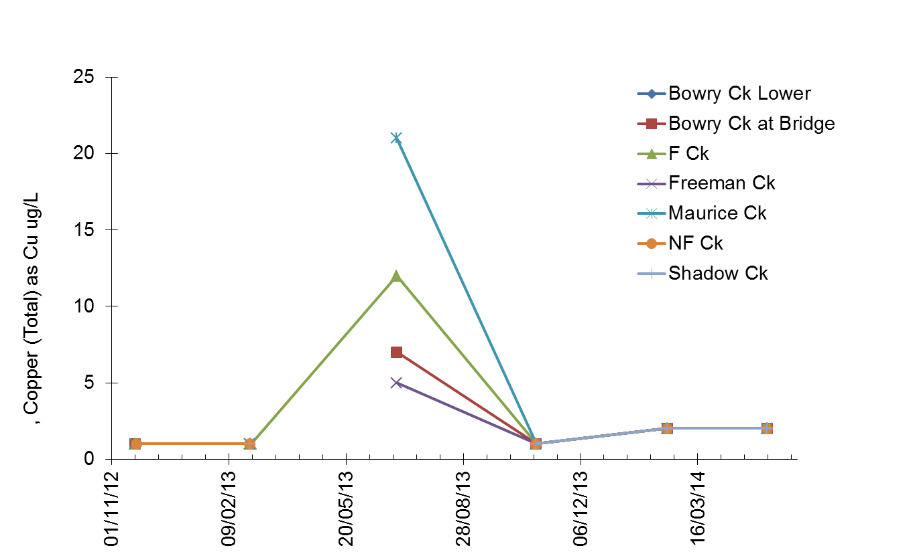
Total Copper at different Long Plains sites.
*Dissolved copper all less than 4ug/L and all samples at or below level of detection
except during 2/7/2013 flood event
Notes:
Add slides to each topic section as necessary, including slides with tables, graphs, and images.
See next section for sample table, graph, image, and video layouts.

Slide 8
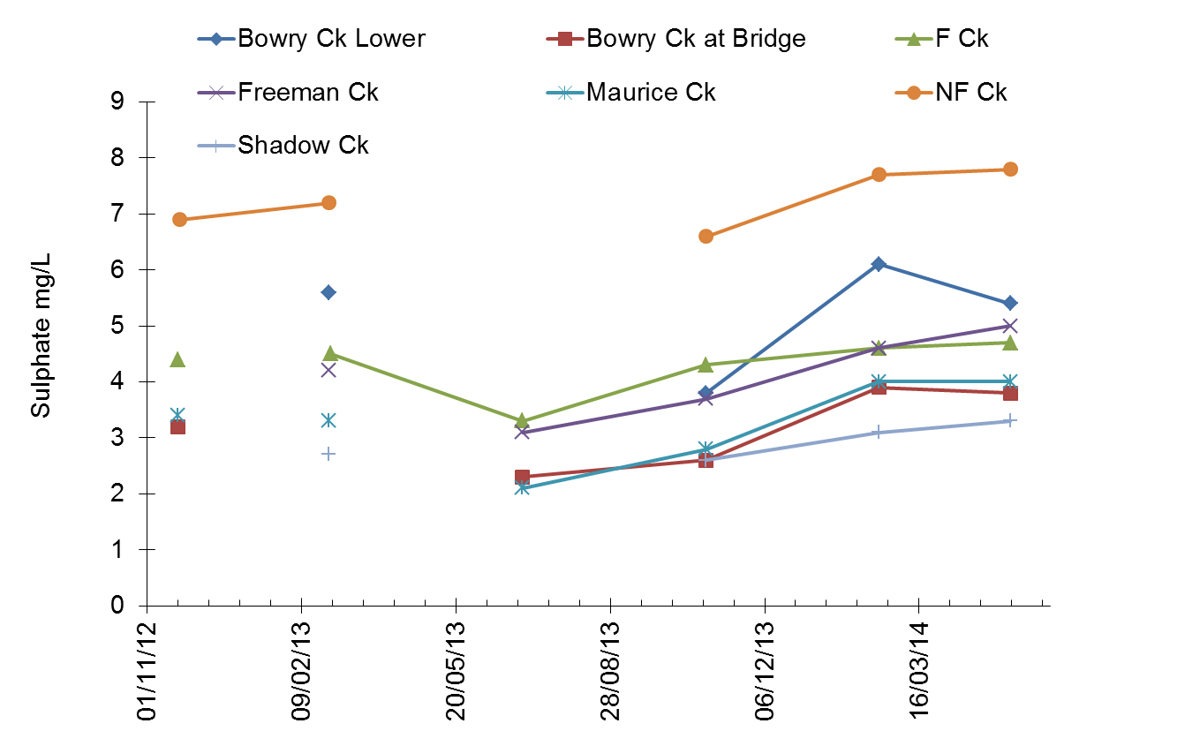
Sulphate at different Long Plains sites.
* Levels considered low and indicate low rates of acid rock drainage in catchment
Notes:
Add slides to each topic section as necessary, including slides with tables, graphs, and images.
See next section for sample table, graph, image, and video layouts.

Slide 9
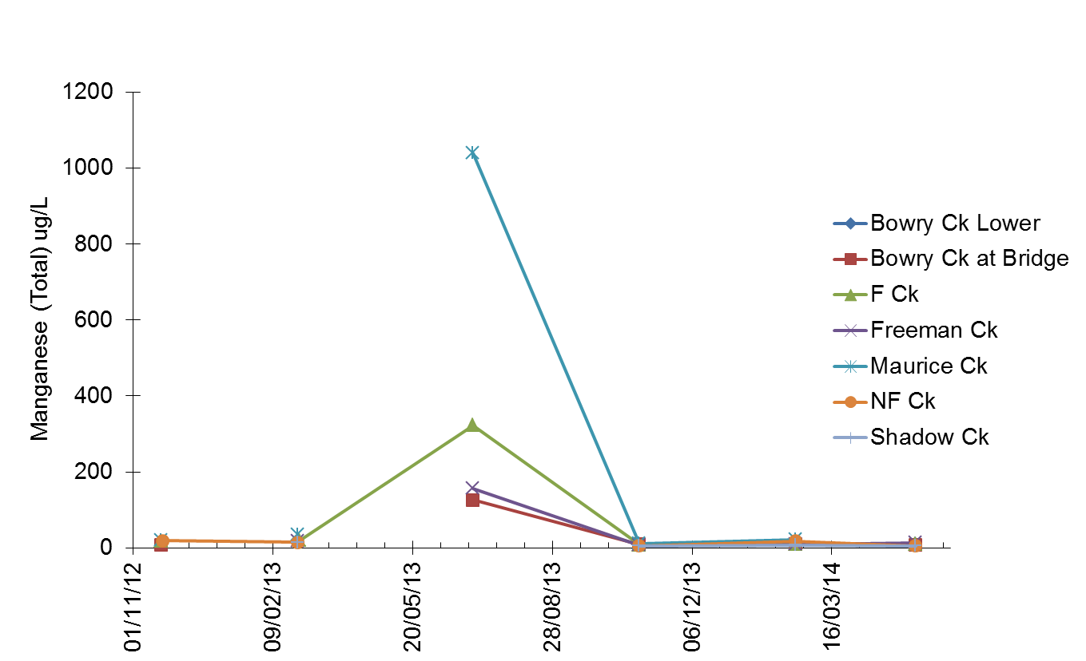
Total Manganese at different Long Plains sites.
Notes:
Add slides to each topic section as necessary, including slides with tables, graphs, and images.
See next section for sample table, graph, image, and video layouts.

Slide 10
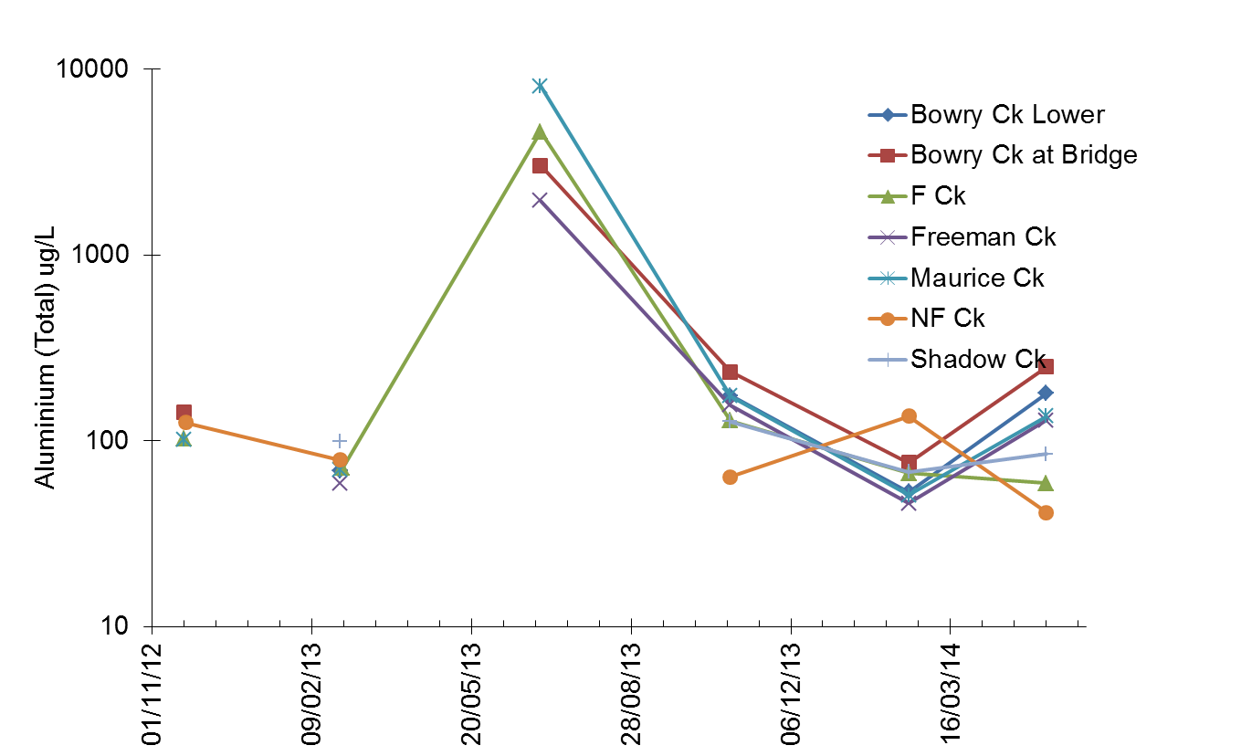
Total Aluminium at different Long Plains sites (Log Scale).
* Levels considered low except during high flow event..
Notes:
Add slides to each topic section as necessary, including slides with tables, graphs, and images.
See next section for sample table, graph, image, and video layouts.

Slide 11
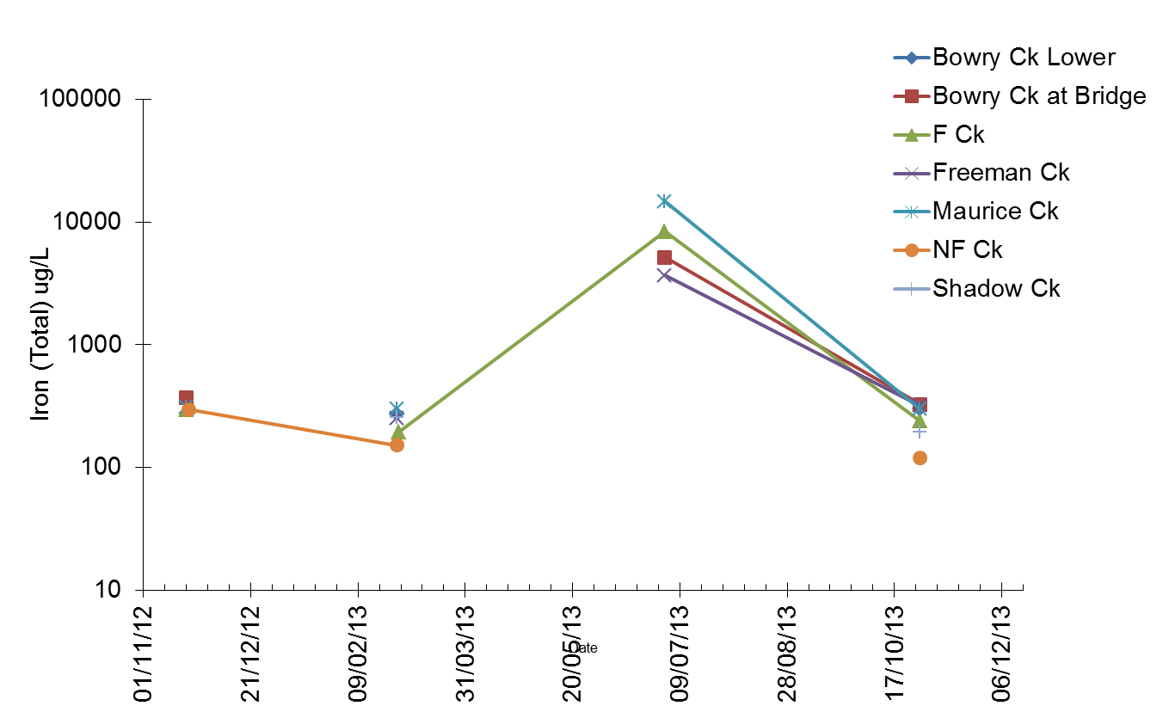
Total Iron at different Long Plains sites (Log Scale).
* Levels considered low, but levels may be associated with land disturbance.
Notes:
Add slides to each topic section as necessary, including slides with tables, graphs, and images.
See next section for sample table, graph, image, and video layouts.

Slide 12
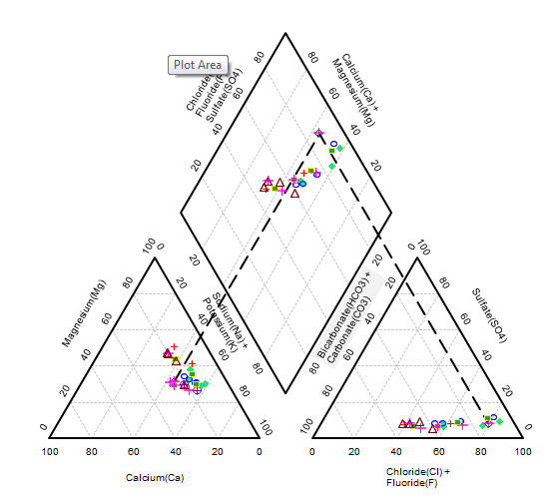

Slide 13
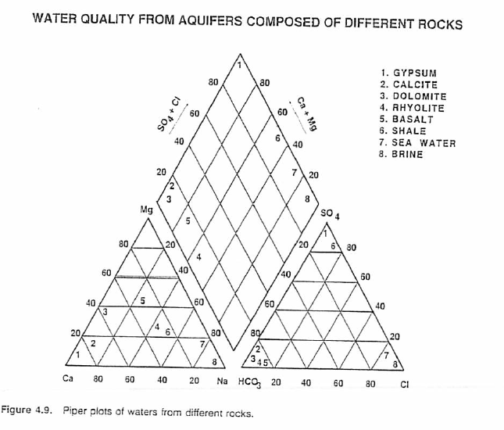

Slide 14
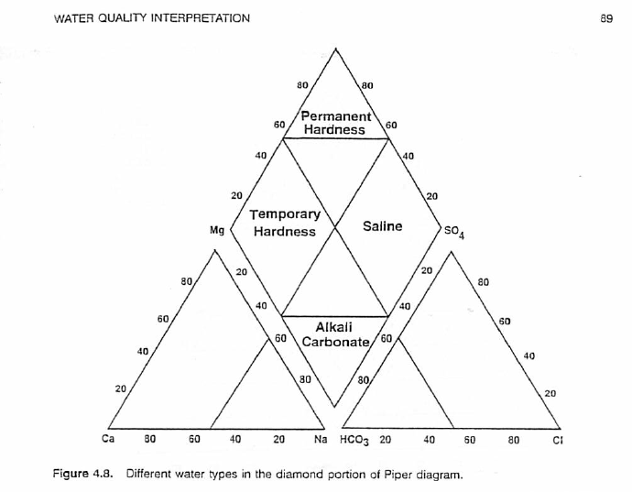

Slide 15
Points for Discussion
Increase in flow between Bowry Upper and lower site
Flow Stations?
Future Monitoring
Notes:
Summarize presentation content by restating the important points from the lessons.
What do you want the audience to remember when they leave your presentation?
Save your presentation to a video for easy distribution (To create a video, click the File tab, and then click Share. Under File Types, click Create a Video.)

Slide 16
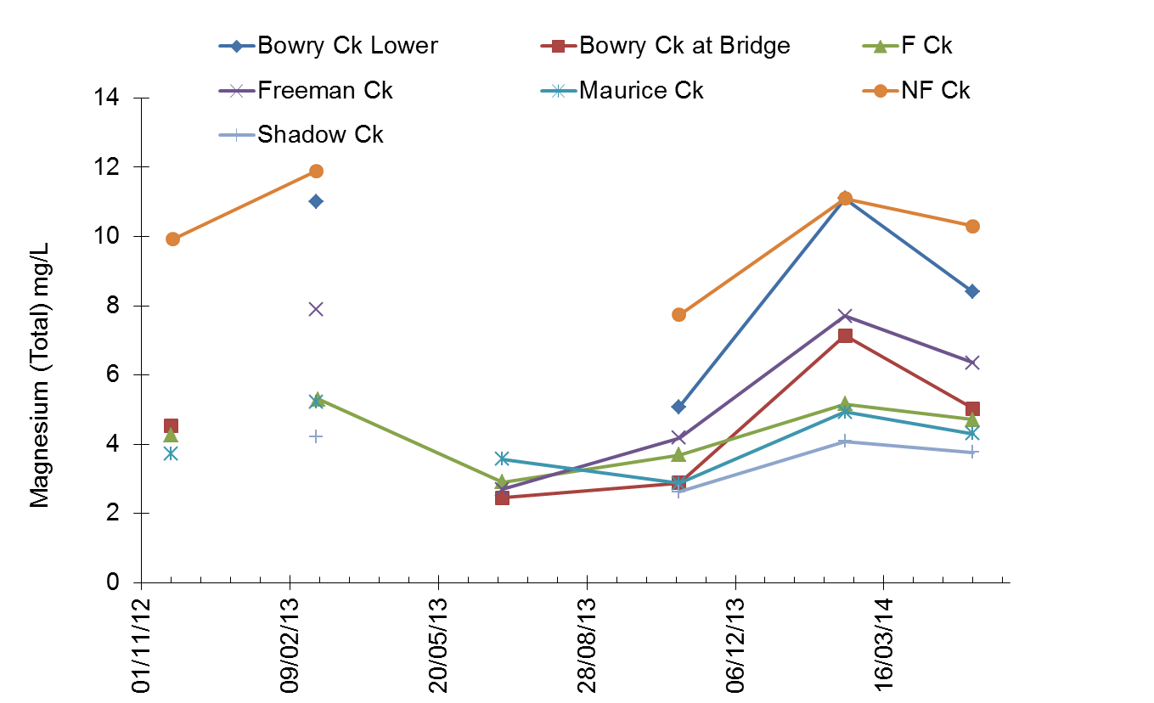
Magnesium Increase within lower Bowry Creek catchment (NF Creek & Bowry Creek)

