Slide 1
A Geochemical study of magmatic Ni-Cu-PGE sulphide mineralization in mafic sills at Melba Flats, Western Tasmania
Reid R. Keays
School of Earth, Atmosphere and Environment
Monash University
October 17, 2014

Slide 2
Executive Summary
The ore-grade Ni-Cu-PGE sulphides at Melba Flats were formed at depth due to interaction of a PGE-undepleted high MgO magma with S-bearing crustal rocks
Some of these sulphides were then picked up as liquid sulphide droplets and transported by later batches of the same magma type
During transport, some of the sulphides were resorbed by the sulphide-undersaturated magma
As a result some of the Fe and the S in the sulphides were taken back into the magma, leaving residual sulphides that were enriched in Cu, Ni, PGE and Se
As it is highly probable that only a small proportion of the Ni-Cu-PGE sulphides formed at depth were transported to their current sites, there is considerable potential for significant amounts of additional sulphides at depth
If present, these sulphides would have somewhat lower tenors than the Melba Flats high grade sulphides
  However, the tenors of these sulphides are likely to be quite economically attractive as the tenors of the Melba Flats sulphides (~10 % Ni and ~5 % Cu) are significantly higher than many Ni-Cu sulphide deposits

Slide 3
Background to Study
This project is a follow-up to the Crawford and Keays (2010) report on Melba Flats prepared for Allegiance Mining
It was set up to address the question:
  did the Ni-Cu-PGE sulphides at Melba Flats acquire their metal tenors at depth when first formed
- or did they start off as sedimentary sulphides that acquired their metal content during transport
If the former, then there may be significant amounts of magmatic Ni-Cu-PGE sulphides at depth in the Melba Flats magmatic system

Slide 4
Geological Background
Magmatic Ni-Cu-(PGE) sulphides were discovered at Melba Flats in ~1893
Total estimated production was 6050 tons @ 9.7% Ni and 4.7% Cu
Much of the production came from high grade (up to 15% Ni+Cu) lodes up to 1m thick that occur in relatively narrow gabbroic sills that were intruded into mudstones, siltstones and volcanic lithiewackes of the Late Proterozoic Crimson Creek Formation
In addition to Ni + Cu, the mineralization contains a considerable amount of PGE
  The highest Pd and Pt values recorded in this study were 3.32 g/t Pd and 1.02 g/t Pt
  The PGE contents of the mineralized rocks at Melba Flats are similar to those of contact Ni-Cu-PGE sulphides at Sudbury, Canada
In drill hole MF 93, the most studied drill hole in this project, the widths of the sills vary from 7m to 59m thick
Melba Flats is about 25 km to the NE of Avebury, a significant hydrothermal Ni deposit

Slide 5
Rosebery
Renison
MELBA
Spine
Henty
Axis
Zeehan
AVEBURY
Mafic - ultramafic outcrop
Granite outcrop
Granite <2km depth
Deposits
Allegiance

Slide 6
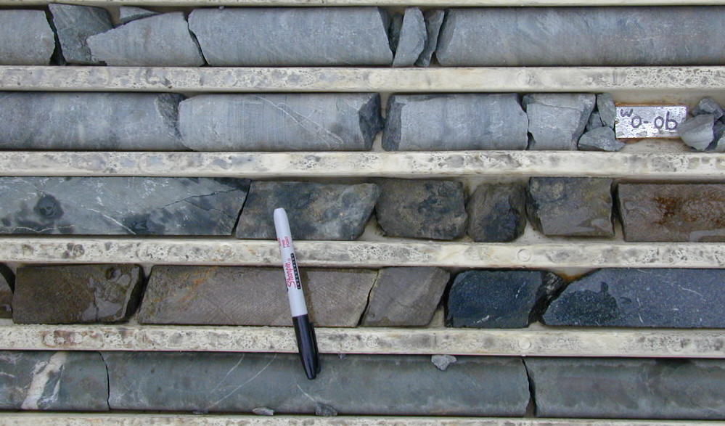
Massive Ni-Cu-PGE sulphides in Melba Flats drill core
-635 ppb Pd, 767 ppb Pt, 69 ppb Rh, 126 ppb Ir, 3.8% Cu, 5.5% Ni

Slide 7
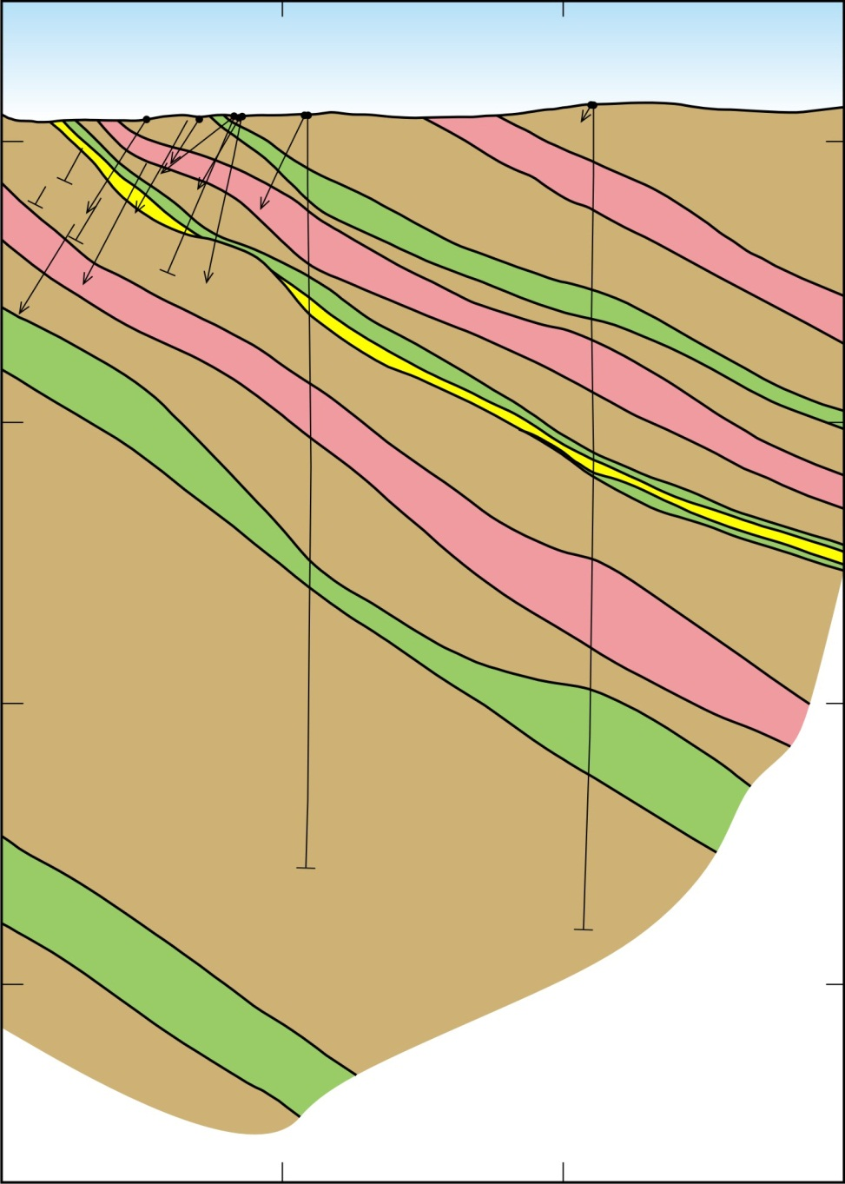
Melba Flats – North Cuni Genets
Section 5367825
2100m RL
MF95
3.2m @ 1.1% Ni & 0.8% Cu
MF88
5.1m @ 0.8% Ni, 0.7% Cu
Crimson Creek
Formation
Greywackes
1900m RL
Gabbro Dykes
366500E
366600E

Slide 8
Important Note
In some of the Melba Flats sills, massive sulphides make up to 85% of the volume of the sills
In other sills, several veins of massive sulphide occur at different depths in the sills
  This suggests that the sulphides were injected into the sills as sulphide melts
There is no contact metamorphic effects in the greywacke host rocks to the sills

Slide 10
Ni vs Depth in MF-23 Sill 2
There are four Ni peaks in this intersection that were produced by massive sulphide aggregates and veins
This provides additional strong evidence that the sulphides were injected as immiscible sulphide liquids into the gabbros
These sulphide melt may have been injected from below or by backward flow
It will be shown below that it is unlikely that the mineralization is a product backward flow of sulphide melts

Slide 11
Magma-type that formed the Melba Flats
Ni-Cu-PGE sulphides
An indication of the magma type from which the higher grade Ni-Cu-PGE sulphides were formed is provided on a scattergram of Pd/Ir vs Ni/Cu ratios
These values are superimposed on the discriminant diagram of Barnes (1990) that provides the fields occupied by rocks formed by different magma types

Slide 12
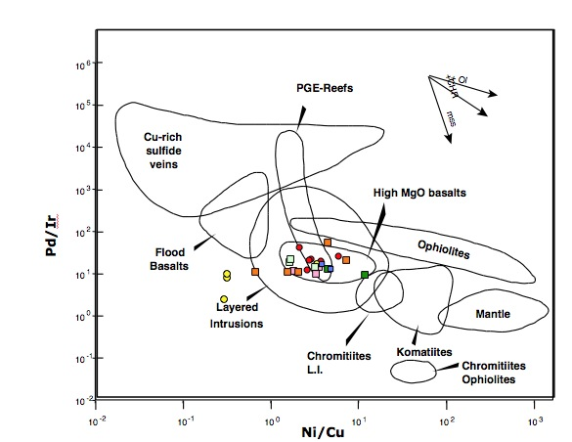

Slide 13
Pd/Ir vs Ni/Cu
The majority of the sulphides plot in the field of high Mg tholeiites
Hence, the ores were formed by a magma that had the same MgO content (~12-13%) as that which the host rocks (Crawford and Keays, 2010)
Magmas that have elevated MgO contents are generally sulphide undersaturated and therefore undepleted in Ni, Cu and the PGE
The three MF 81A samples that lie outside the high Mg tholeiite field are massive sulphides
  they have lost some Pd, Pt and Cu during fractionation of the sulphide melt that produced them
Symbols: red circles (MF 19 Assays); pink squares (MF 95); yellow circles (MF 81 A); green squares (MF 93-sill 1); sky blue squares (MF 93-sill 2); blue squares (MF 93-sill 3); orange squares (MF 93-sill 4)

Slide 14
A note on fractionation of sulphide melts
Sulphide melts can undergo fractionation, just as silicate melts do
The first phase to segregate from the sulphide melt that produced the sulphide mineralization at Melba Flats would be a Monosulphide solid solution (Mss) that would be composed mainly of FeS plus Ni and Co in addition to Ir, Ru and Rh
The residual sulphide melt would be enriched in Cu, Au, Pd and Pt
Migration of the Cu-rich sulphide melt away from the Mss (as would almost certainly have happened if the Melba Flats sulphides had flowed backwards down the plumbing system) would have produced significant fractionation of Cu from Ni and Pd from Ir, etc.

Slide 15
There is a reasonable correlation between Cu and Ni
-the divergence in Cu/Ni ratios may in part be due to limited fractionation of a sulphide melt

Slide 17
Pd vs Pt
Excellent Pd-Pt correlation between Cu-Ni-rich and Cu-Ni-poor sulphides
The continuum in ratios indicates the sulphides in all sills are co-magmatic
This also indicates that all of the PGE in the rocks (including those with very low sulphide contents) are hosted by sulphides
The scatter in ratios with higher PGE contents may be due to the presence of Platinum Group Minerals
Also, the MF-19 “Assays” samples were analysed in a different lab

Slide 19
Ir vs Pd
There is a reasonably strong correlation between Ir and Pd
As Ir and Pd are strongly partitioned during fractionation of sulphide melts, this suggests the sulphide melts underwent very little fractionation
If fractionated, the high Pd samples should have low Ir contents, which they do not
It is hence unlikely that the sulphides were emplaced at higher levels in the plumbing system and ran back down the system under gravity

Slide 21
Rh vs Pt
There is strong correlation between Rh and Pt
This means that there was no fractionation of a sulphide melt during emplacement of the sulphides
It is unlikely that there was backward flow of a sulphide melt as this would have resulted in fractionation of Ni from Cu and Pd from It
The strong correlation between Rh and Pt excludes any possibility that the sulphides are hydrothermal in origin

Slide 22
R-factor – volume of silicate magma/volume of sulphide melt

Slide 23
Pd vs Cu
The dashed line separates samples that were formed from PGE-undepleted magmas from those formed from PGE-depleted magma
The samples lying above the dashed line were formed from a sulphide-undersaturated magma under a range of R-factors
Samples with low Pd/Cu ratios were formed by magmas that became depleted the PGE due to scavenging by magmatic sulphides
It will be argued that in the case of Melba Flats, this scavenging of the PGE occurred during transport of immisicible magmatic sulphides formed at depth

Slide 25
Cu/Pd variations in MF 23-Sill 4
The mantle has a Cu/Pd ratio of ~ 7500
Rocks that have much higher Cu/Pd ratios were formed from magmas that were strongly depleted in Pd and the other PGE
This would have been caused by a sulphide-saturation event which would have also removed Cu and Ni
With the exception of the gabbros at the base and the top of the sill, the gabbroic rocks in this sill were formed by magmas that had undergone a significant sulphide-saturation event

Slide 26
Notes on S/Se geochemistry
Mantle-derived magmas have a S/Se ratios of 2500 ± 500
Most S-bearing sedimentary rocks have considerably larger S/Se ratios
Hence, S/Se ratios can be used to determine if a portion of the S component of magmatic sulphides is “mantle” in origin or “crustal” in origin
Whereas the strongly mineralized rocks at Melba Flats have “mantle” S/Se ratios, many of the poorly mineralized (but still S-bearing) have “crustal” S/Se ratios
If a S-undersaturated magma were to transported sulphides with low metal tenors and high S/Se ratios, those sulphides could be partially resorbed by the magma, taking Fe and S back into the magma but enriching the residual sulphides in the PGE, Cu,Au, Ni and Se, all of which have larger sulphide melt/silicate melt partition coefficients

Slide 28
Cu vs S/Se
Most of the well-mineralized rocks at Melba Flats have narrow range in S/Se
The three MF 81A samples with elevated Cu that have higher S/Se are the three outliers on the Pd/Ir vs Ni/Cu plot
  The Se in these samples probably entered the Cu-rich sulphide melt
The majority of the poorly mineralized rocks have considerably higher S/Se ratios, which are indicative of crustal S

Slide 30
Cu tenor vs S/Se
In general, Cu tenors (=Cu (100) increase with decreasing S/Se
The high S/Se ratios of the low Cu(100) samples indicate that they contain a significant amount of crustal S
These patterns suggest that the sulphides initially had high S/Se (and high (=crustal) δ³⁴S) but during transport in a S-undersaturated magma, Fe and S were resorbed by the magma
  This resulted in the residual sulphides becoming enriched in Cu, PGE and Se
Two of the samples have sub-mantle S/Se ratios
  This indicates even greater interaction with the carrier magma than with the other sulphides

Slide 33
Cu and Ni vs Depth in MF 81A
Massive sulphides occur at the base of the sill
-their Cu and Ni contents reach maximums of 4.0 % and 14.5 %, respectively
-both Cu and Ni decrease very rapidly up through the sill
This distribution of metals would be produced if the sulphides had been carried as immiscible sulphide droplets by the magma and then settled to the base of the sill once the magma stopped flowing

Slide 35
S/Se vs depth in MF 81A
The massive sulphides at the base of the sill have a narrow range (2020 to 2770) in S/Se ratios that fall within the mantle range
Samples with lower sulphide content higher in the sill have higher S/Se (up to 6000) ratios that indicate a component of crustal S
There is a strong inverse correlation between S/Se and Cu and Ni (as well as the PGE)

Slide 36
Genetic Model
The Melba Flats Ni-Cu-PGE sulphides were deposited at depth due to interaction of a sulphide-undersaturated high-MgO magma with S-bearing crustal rocks
This produced magmatic sulphides with elevated S/Se ratios (and probably high δ ³⁴S values)
Some of these sulphides were then picked up and transported by later batches of the same magma type
During transport, some of the sulphides were resorbed by the sulphide-undersaturated magma
As a result some of the Fe and the S in the sulphides were taken back into the magma, leaving residual sulphides that were enriched in Cu, Ni, PGE and Se
This increased the metal tenors of the sulphides but decreased their S/Se ratios
Conversely, the S/Se ratios of the carrier magma increased while its PGE content decreased due to scavenging into the residual sulphides
Once the magmas flowing rate in the sills slowed down, the sulphide melt droplets settled to the bases of the sills
However, in some cases. the sulphide melts were remobilized and injected into the sills at higher levels in them, as in the case of MF 23-Sill 2

Slide 37
Mineralized vs barren gabbro sills
Were the mineralized sills produced by different magmas to those the produced by barren sills?
This question can be addressed by using spidergrams that are constructed utilizing the petrogenetic indicator elements

Slide 39
Extended Spidergram
There is no difference in the petrogenetic trace patterns between the barren and the mineralized sills/dykes
This provides strong evidence that all the sills are co-magmatic
There is a small negative Nb anomaly, which is consistent with some crustal contamination

Slide 41
(Nb/Yb)PM vs (Th/Yb)PM*
Decreasing (Nb/Yb)PM and increasing Th/Yb)PM indicate increasing degrees of crustal contamination
Most samples have undergone a modest degree of crustal contamination (<5%)
The solid line represents a mixing line between a primitive magma (with low (Th/Yb)PM and a crustal contaminant (with high (Th/Yb)PM
The tightness of the array indicates that there was excellent homogenization between the parental magma and the crustal contaminant
* PM- values for each element have normalized to their concentration in the Primitive Mantle

Slide 42
Gabbroic sill at Avebury
Samples were analysed from a gabbroic sill in the Crimson Creek Formation at Avebury
As the sequence is overturned, this sill is in the stratigraphic footwall to the Avebury ultramafic body
These samples were collected and analysed to see if they are co-magmatic with the gabbroic sills at Melba Flats
The study of this sill is a part of Marcus Phua’s MSc project on Melba Flats

Slide 44
Extended Spidergram-Avebury Gabbro Sill
The patterns for the two Avebury samples (A-254) are completely different to those of the Melba Flats sills
Hence, the Avebury sill is not co-magmatic with the Melba Flats sills
The Avebury samples define, with the exception of Ce, the U-shaped REE pattern that is typical of boninites
They also have very strong negative Nb anomalies, a feature that is also typical of boninites
Although the Avebury gabbroic sill was probably affected by the same fluids that ultimately came off the Heemskirk granite and metasomatized the Avebury ultramafic, the geochemical data do suggest that the Avebury gabbroic sill was formed by a boninitic magma
If this is indeed the case, it would strengthen the case that the Avebury ultramafic body was formed by a boninitic magmas and is indeed a member of the Early Cambrian Heazlewood River ultramafic/mafic suite of intrusions

Slide 45
Sulphur Isotope data for Avebury sulphides
Sulphur isotopes were measured in 18 Avebury samples which contained variable amounts of Ni
These data were collected as a part of Ben Mackay-Scollay’s BSc (Honours) project on Avebury
The samples were analysed at Queens University in Canada
The data are reported here because of the possible relevance to mineralization at Melba Flats

Slide 46
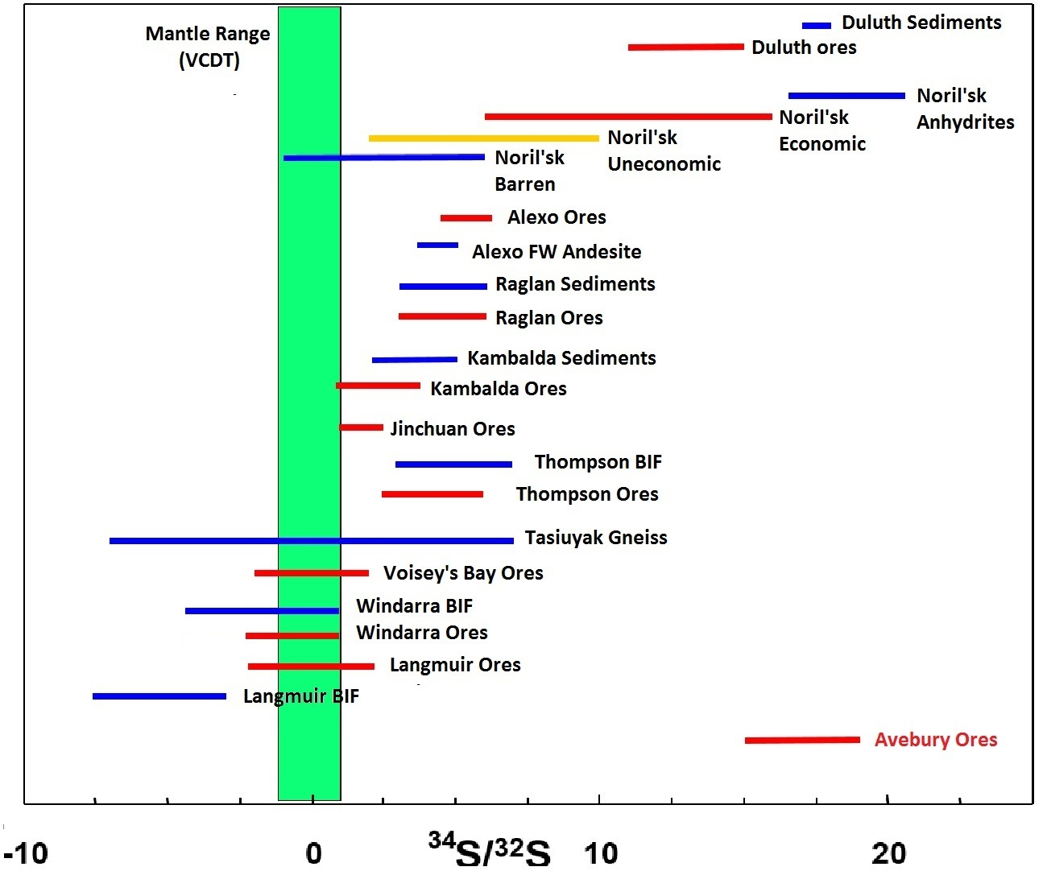

Slide 47
Sulphur Isotope Data for Avebury mineralization
Average δ ³⁴S = 17.1 ± 1.1
The Avebury sulphides have higher δ ³⁴S values than the majority of magmatic Ni-Cu sulphide deposits with the exception of Noril’sk (Russia) and Duluth (USA)
These high and very uniform δ ³⁴S values rule out any possibility that Avebury is a strongly metasomatised magmatic NiS deposit
The high δ ³⁴S values indicate that the Heemskirk Granite, the source of the metasomatising fluids, could not have been the source of the heavy S
The most logical source of the heavy S would be the same as that of the Ni, this being magmatic Ni sulphides somewhere at depth in the plumbing system at Avebury
Is it possible that the magmatic sulphides at Melba Flats were derived from a similar source?

Slide 48
Confirmation of the Genetic model for Melba Flats
The δ³⁴S values of the Melba Flats sulphides will be determined to test the model proposed for their petrogenesis
If the higher grade magmatic sulphides at Melba Flats are the product of partial resorption of sulphides produced by the interaction of a primitive magma with S-bearing sedimentary rocks that had high S/Se ratios, they might also have high δ³⁴S values
Although some of the S in those sulphides would be assimilated by the sulphide undersaturated magma (and therefore increase its S/Se ratios) this would probably not fractionate the S isotopes
Hence, the genetic model proposed for Melba Flats would be confirmed if the higher grade sulphides have high δ³⁴S values

Slide 49
References
Barnes S-J 1990 The use of metal ratios in prospecting for a platinum-group element deposit Journal of Exploration Geochemistry. 37: 91-99
Crawford AC, Keays RR (2010) Magmatic Ni-Cu sulfides in mafic sills at Melba Flats, Western Tasmania-a geochemical investigation. Unpubl. Report prepared for Allegiance Minerals, 34 pages.

