Slide 1
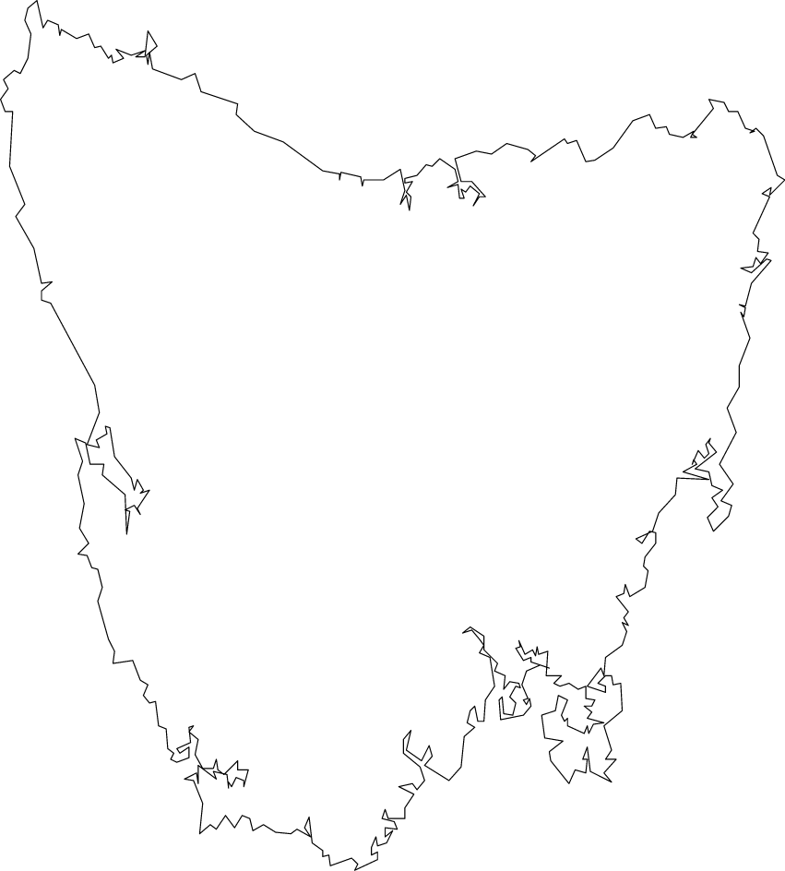


Petrogenesis of the gabbroic intrusions hosting magmatic Ni-Cu-PGE sulphides at Melba Flats, Western Tasmania
Supervisors: Professor Reid Keays
Professor David Phillips
The Association of Applied Geochemists

Slide 2
Outline
History
Regional Geology
Local Geology
Sediments
Gabbroic Intrusions
Ni-Cu-PGE Sulphides
Aims
Significance
Approach
Sediments
Gabbroic Intrusions
Ni-Cu-PGE Sulphides
Progress
Preliminary Results
Future Work

Slide 3
History
Previously known as the Five-mile deposit or the Cuni deposit
First discovered in 1893 and worked intermittently until 1948
Estimated production of 10,000 tonnes at an average grade of 9.7% Ni and 4.7% Cu
Discovery of the Avebury deposit nearby, led to renewed interest in the Melba Flats deposit

Slide 4
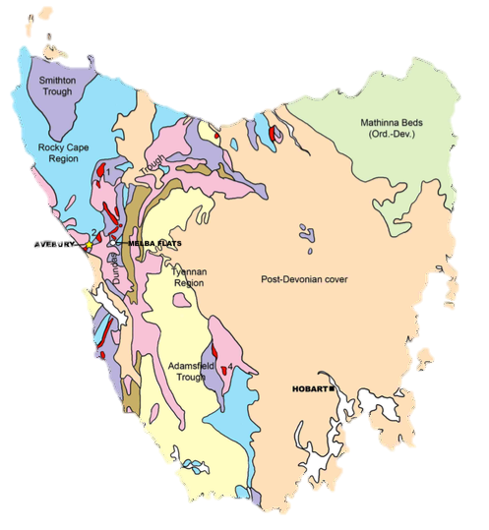
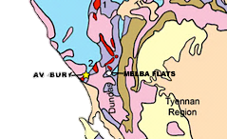

Regional Geology
Ordovician–Devonian
Eocambrian–Cambrian
Mt Read volcanics and correlates
Precambrian–comparatively unmetamorphosed
Precambrian–metamorphosed
Ultramafic-mafic complexes

Slide 5
Regional Geology
Rosebery
Renison
MELBA FLATS
Spine
Henty
Axis
Zeehan
AVEBURY
Mafic - ultramafic outcrop
Granite outcrop
Granite <2km depth
Allegiance
Deposits

Slide 6
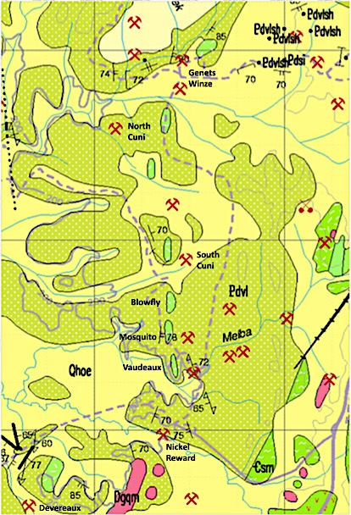
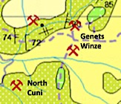

Local Geology
Alluvium and talus
Melba Flats gabbroic intrusions
Volcaniclastic lithicwacke and siltstone (Possible correlate of Crimson Creek Formation)

Slide 7
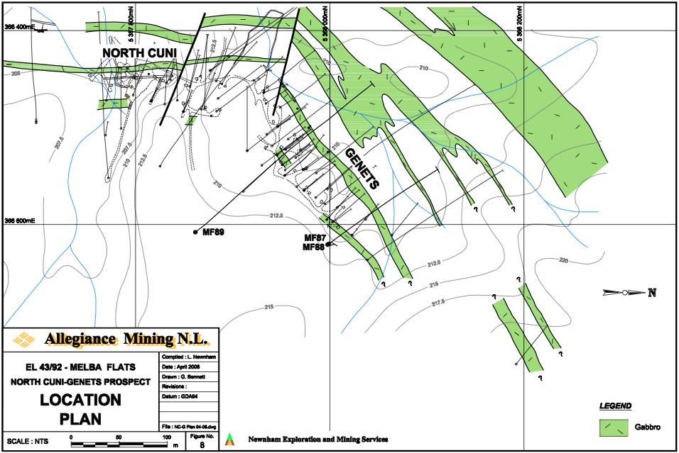
Local Geology

Slide 8
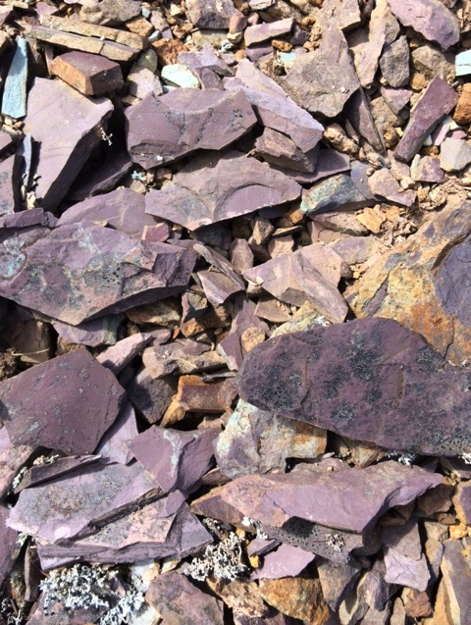
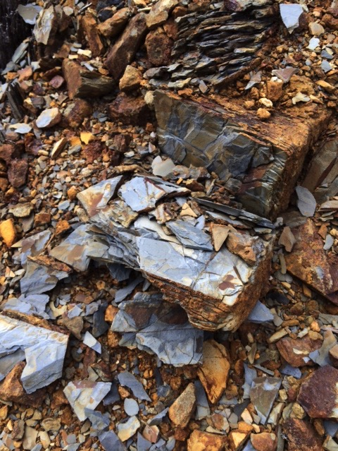
Sediments
Red lithicwacke
Grey lithicwacke

Slide 9
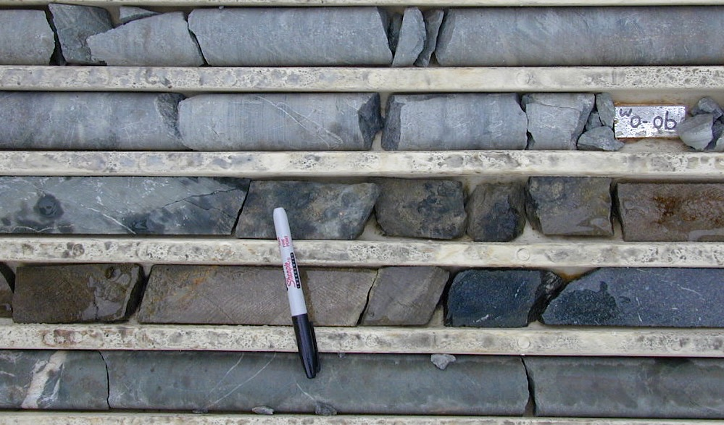
Gabbroic Intrusions

Slide 10
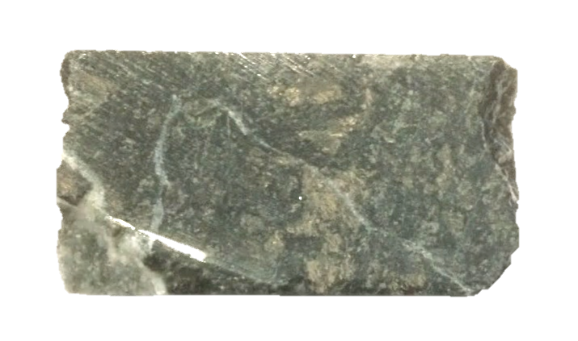
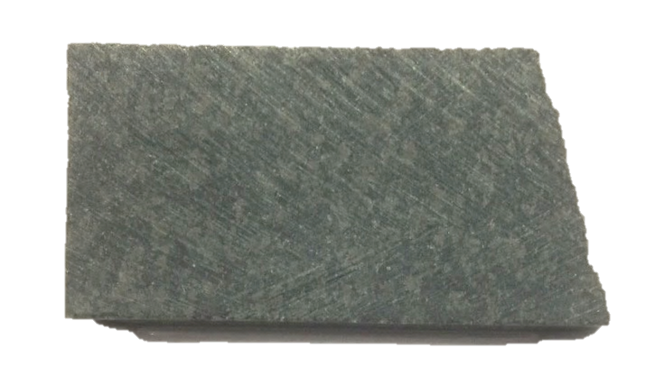
Gabbroic Intrusions
Mineralized
Unmineralized

Slide 11
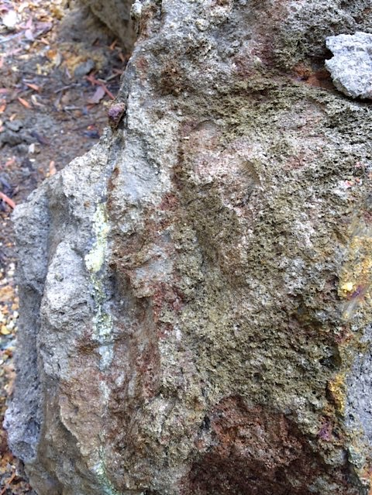
Ni-Cu-PGE Sulphides
Disseminated Sulphides
Massive Sulphides

Slide 12
Aims
Ascertain the affiliation and age of the sediments;
Establish the affiliation and age of the gabbroic intrusions;
Determine the tectonic setting in which emplacement of the gabbroic intrusions had occurred;
Establish if Ni-Cu-PGE mineralization was formed in situ or at depth; and
Define the relationship in time and space between the Avebury Ni deposit and the Melba Flats Ni-Cu-PGE deposit.

Slide 13
Significance
Eradicate ambiguities in relation to the provenance of the sediments
Constrain the tectonic setting of the gabbroic intrusions
Establish the petrogenesis of the Melba Flats Ni-Cu-PGE deposit
Permit classification of the Melba Flats Ni-Cu-PGE deposit
Determine the possible existence of a new mineralized terrain in Western Tasmania

Slide 14
Approach – Sediments
Sediment Affiliation:
Petrographic examination (UOM)
Polished thin sections
Geochemical analysis (UOM)
Major elements – XRF
Minor and trace elements – Quadrupole ICP-MS
Sulphur isotopes
Age/Tectonic Setting:
Detrital Zircon Geochronology (UOM)
Laser Ablation ICP-MS
Detrital Muscovite Geochronology (UOM)
⁴⁰Ar/³⁹Ar using ARGUSVI-MS

Slide 15
Approach – Gabbroic Intrusions
Magmatic Affiliation:
Petrographic examination (UOM)
Polished thin sections
Geochemical analysis (BV/GL)
Major elements – XRF
Minor and trace elements – Laser Ablation ICP-MS
PGE elements – NiS-FA followed by ICP-MS
Age/Tectonic Setting:
Zircon Geochronology (ANU/Curtin)
SHRIMP
Hornblende Geochronology (UOM)
⁴⁰Ar/³⁹Ar using ARGUSVI-MS

Slide 16
Approach – Ni-Cu-PGE Sulphides
Origin of Ni-Cu-PGE Sulphides:
Petrographic examination (UOM)
Polished thin sections
Geochemical analysis (BV/GL)
Major elements – XRF
Minor and trace elements – Laser Ablation ICP-MS
PGE elements – NiS-FA + ICP-MS
Sulphur isotopes

Slide 17
Progress
Thin section preparation for petrographic studies
Sample preparation for geochemical analyses
Mineral separation for age dating purposes
Detrital zircon and muscovite from sediments
Zircon and hornblende from gabbroic intrusions
Detrital Zircon U-Pb dating using LA-ICPMS
Major/trace elements analyses of sediments

Slide 18
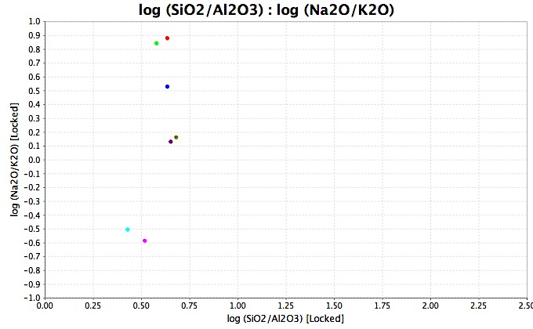
Preliminary Results
Litharenite
Greywacke
Subarkose
Sublitharenite
Quartz
Arenite
Arkose
Classification of Terrigenous Sandstones (Pettijohn et al. 1972, adapted by Herron 1988)

Slide 19
Preliminary Results

Slide 20
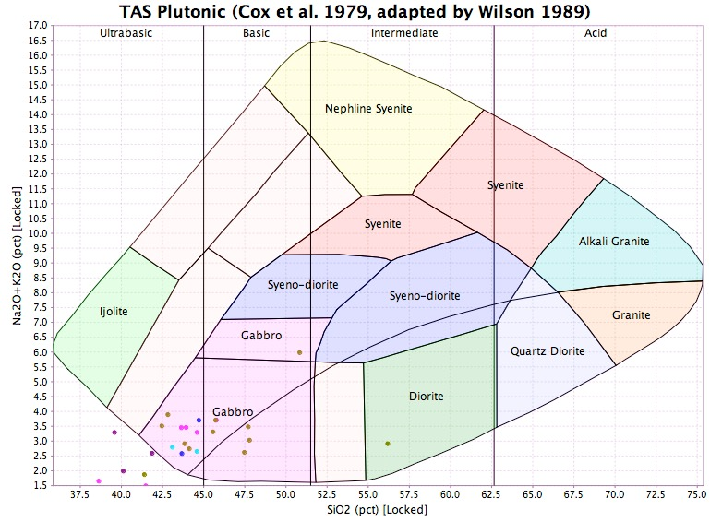
Preliminary Results
Classification of Plutonic Rocks (Cox et al. 1979, adapted by Wilson 1989)

Slide 21
Preliminary Results

Slide 22
Preliminary Results

Slide 23
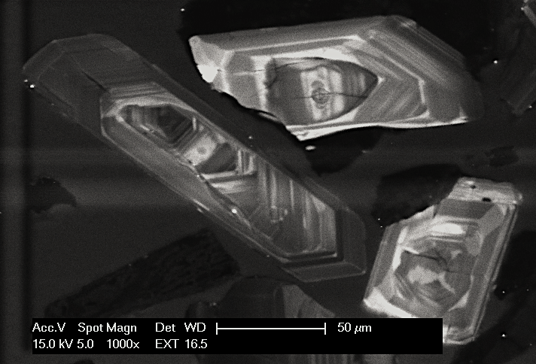
Preliminary Results

Slide 24
Preliminary Results
c. 672.5 ± 2.3 Ma (MSWD = 2.2)
AVEBURY - A231 (n=79)
c. 667.0 ± 2.5 Ma (MSWD = 2.4)
AVEBURY - A207 (n=105)
c. 675.2 ± 3.6 Ma (MSWD = 2.0)
AVEBURY - A150B (n=67)
c. 670.6 ± 3.9 Ma (MSWD = 2.8)
MELBA FLATS - MF83 (n=60)
c. 672.5 ± 3.0 Ma (MSWD = 2.3)
MELBA FLATS - MF40 (n=88)
c. 666.9 ± 2.8 Ma (MSWD = 1.9)
MELBA FLATS - MF23 (n=82)
c. 654.4 ± 4.3 Ma (MSWD = 1.8)
COTTON BRECCIA - CB01 (n=61)

Slide 25
Preliminary Results
Brown (1991) suggested an affiliation to Dundas Group (c. 510 - 500 Ma)
Adabi (1997) proposed an age range of c. 640 – 580 Ma for the Crimson Creek Formation
Meffre et al. (2004) proposed an implied age of c. 580 for Crimson Creek Formation
Detrital Zircon U-Pb dating suggests an age around the range of c. 675 - 667 Ma

Slide 26
Future Work
Provenance/Depositional Age of Sediments
Characterization and classification of detrital zircons
In-depth statistical analysis of laser ablation spot analyses
Detrital Muscovite Geochronology of Sediments
⁴⁰Ar/³⁹Ar using ARGUSVI-MS
Petrogenesis of Melba Flats Ni-Cu-PGE deposit
Interpretation of major, trace, and PGE analyses
Establish tectonic setting of the gabbroic intrusions
Sulphur isotopes
Hornblende/Zircon Geochronology of Gabbroic Intrusions
⁴⁰Ar/³⁹Ar using ARGUSVI-MS
SHRIMP

