Slide 1
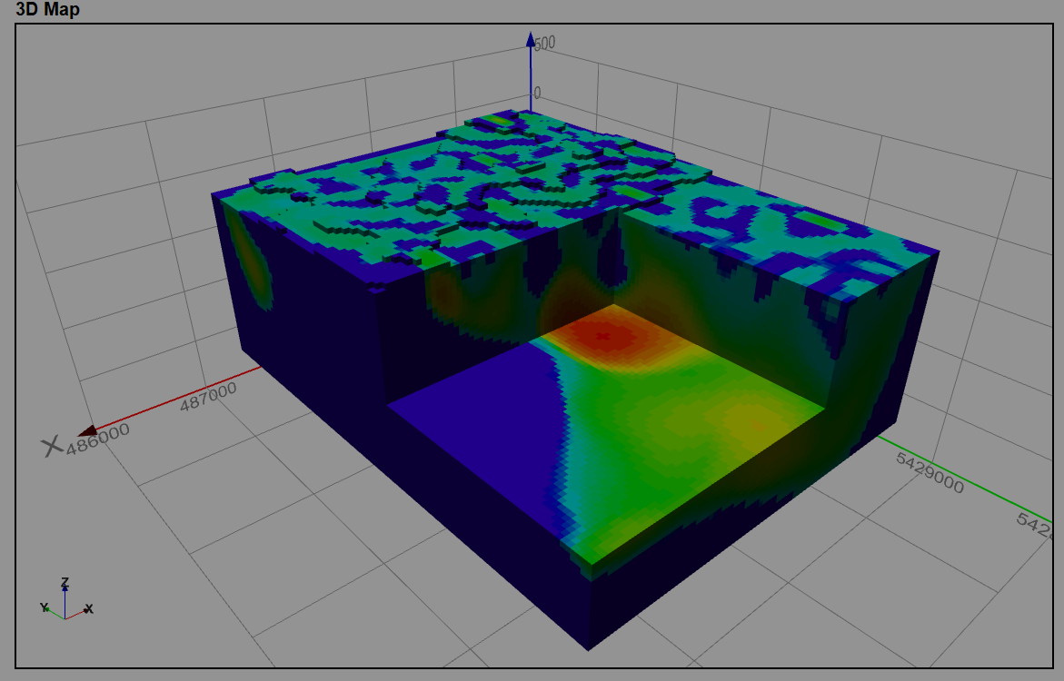
Rookery Creek unconstrained smooth model
Kate Hine, Mitre Geophysics

Slide 2
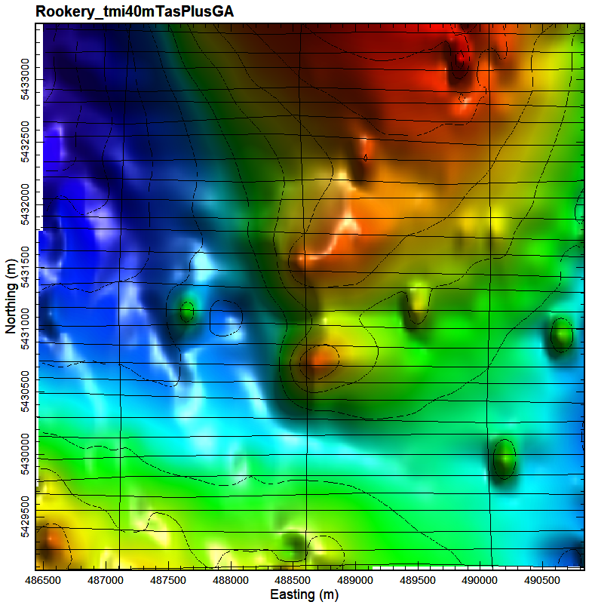
Introduction
Josh Phillips (JP geoscience) requested an unconstrained smooth model inversion of a weak (~15nT) magnetic anomaly near Rookery Creek
The anomaly is roughly circular, ~600m wide
It sits on a larger, apparentely moderately east dipping, basement magnetic layer. The east dip is clear in the models
The existing magnetic data is the 1988 Beaconsfield fixed wing aeromag survey, on 150m E-W lines (shown to the right)
The width and character of the anomaly suggest a shallow, weakly magnetic source, possibly dipping towards the east
There is no obvious remanence. This does not mean there is no remanence, just that it is not obvious
I used the mginv3D algorithm developed by John Paine (Scicomapp Pty Ltd), which is based on the UBC approach to inverse modelling
The model mesh is 40x40x40m
For the TMI model, compression used is Daubechies Wavelet 2, with moderate depth weighting (beta 3, znot 100) and for the VRMI model default depth weighting is used
Terrain model is the 5m GA elevation model
TMI inversion uses the grid data with a terrain offset of 80m. This produced a better fit in this area.
The VRMI (vector residual magnetic intensity) inversion used the transformed VRMI grid and 80m constant terrain offset.
5nT contours, TMI and flight path

Slide 3
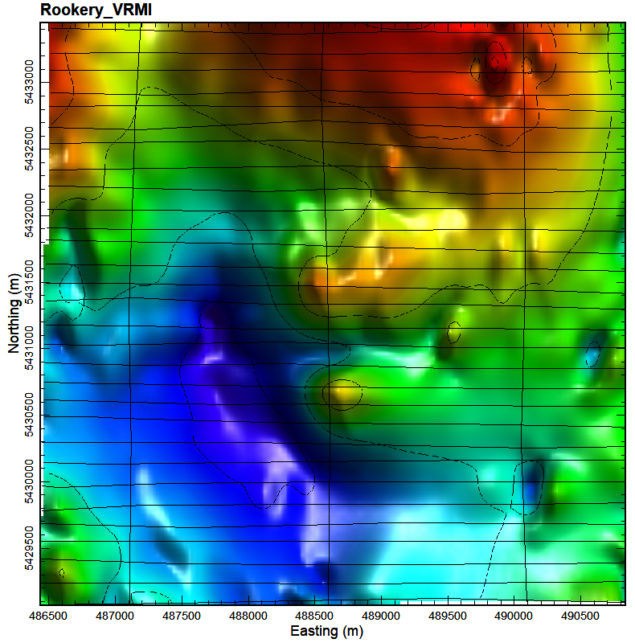
……continued
Why/what is VRMI?
  VRMI is a non-scientific approach of minimising the effect of remanent magnetisation
  It is the magnitude A of the anomalous magnetic field response B, that is A = sqrt(Bx2+By2+Bz2)
  VRMI algorithm attempts to put the magnetic high directly on top of the actual magnetic source whereas in areas of strong remanence (which is very common), the TMI peak is offset laterally
    Thus, for data with strong remanence, any model which uses the TMI-only (i.e. assumes there is no remanence) will place the magnetic anomaly in the wrong place
  We use the VRMI model to see if the TMI is badly affected by remanence. If there is a big offset (laterally) then this is evidence that the TMI model is invalidated by remanence and should not be drilled.
  A model which uses VRMI usually makes everything deeper, wider, less magnetic, and removes deep sources. This is a result of the way that VRMI is calculated.
VRMI is not reliable, but so is TMI modelling with no information on remanence
5nT contours, VRMI and flight path

Slide 4
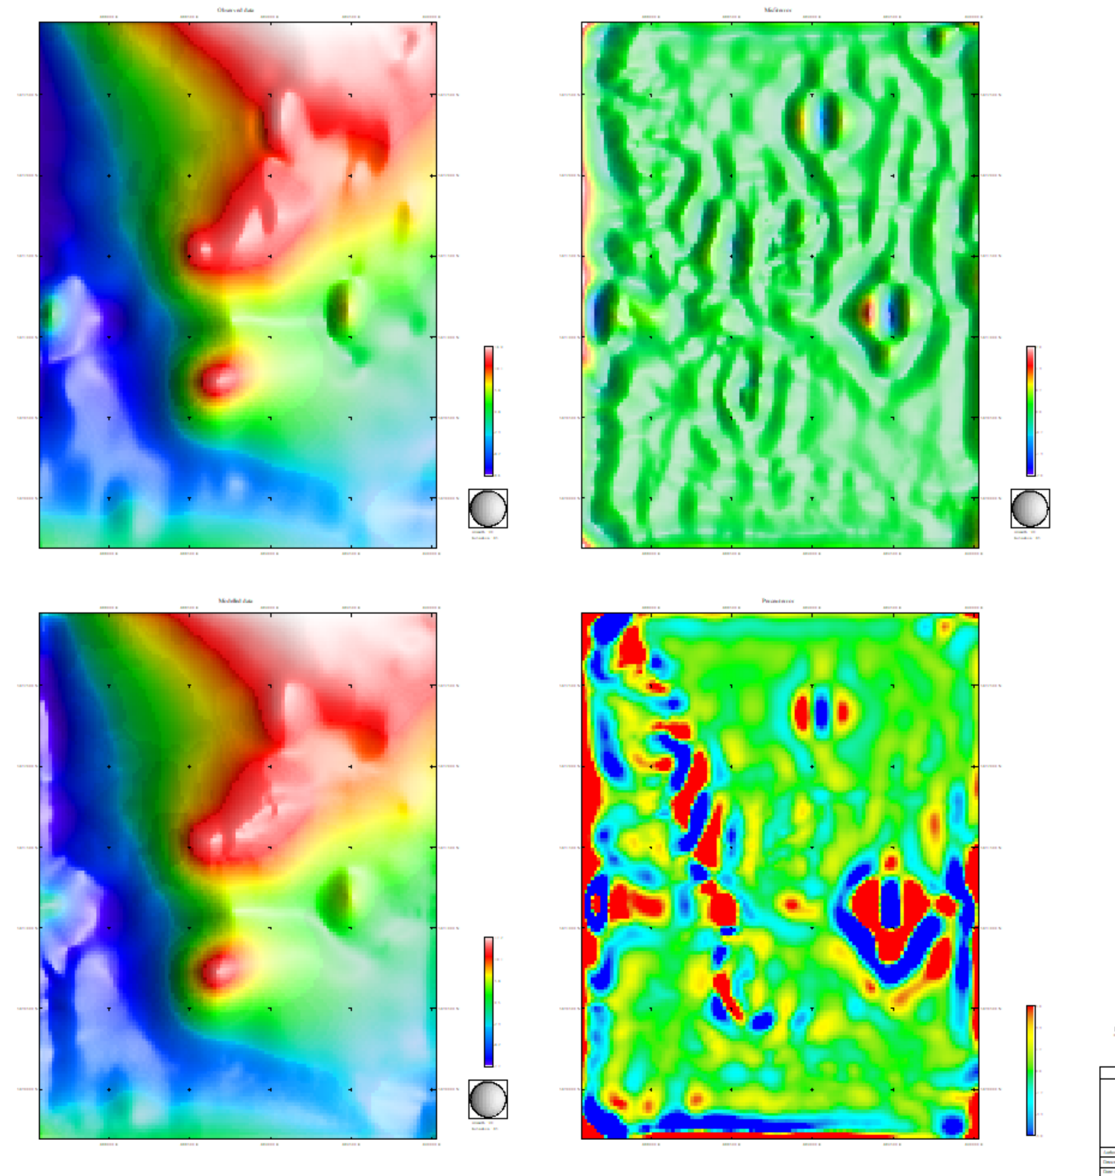
Inversion quality analysis
RookeryCk_VRMI_coarse msh&sus
Houses
The misfit in this area is due gridding errors surrounding high amplitude magnetic spikes from houses. There are several ‘house’ anomaly in the survey area, shown on this slide and the next

Slide 5
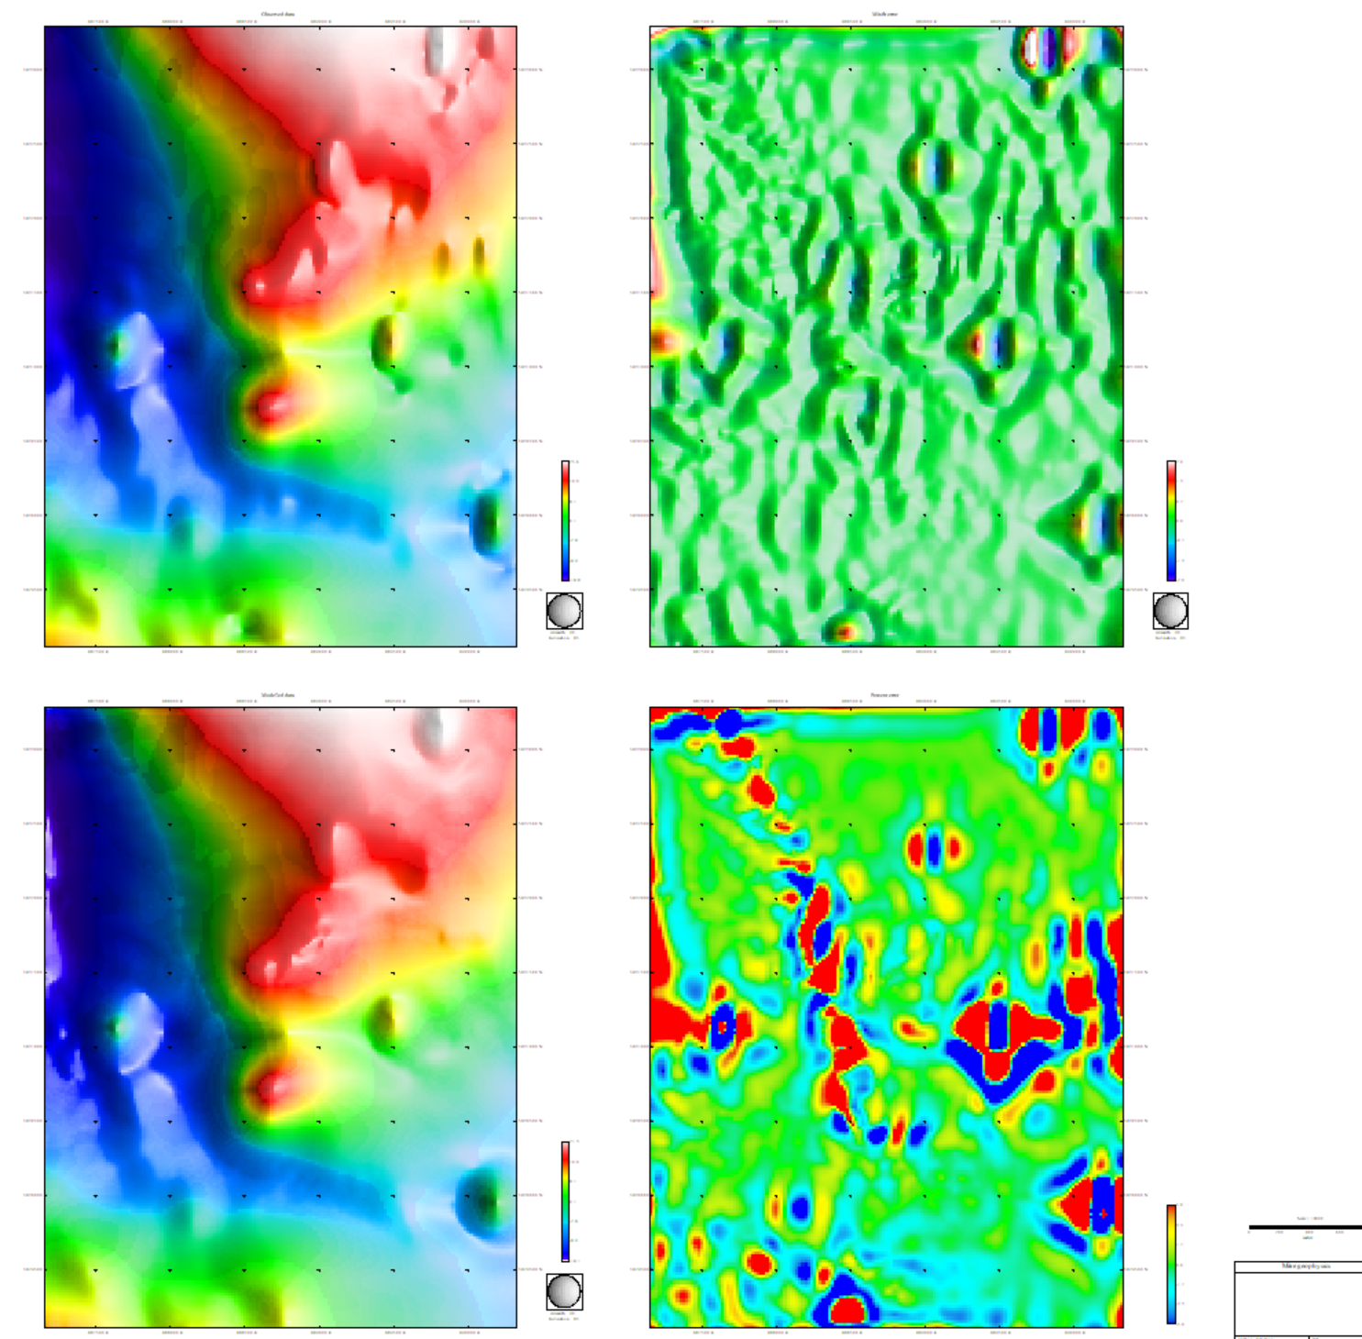
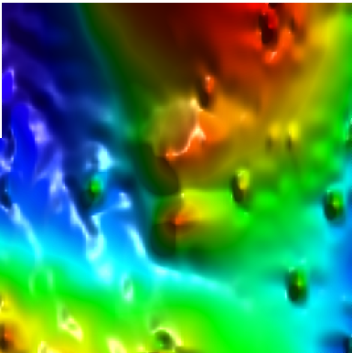
Inversion quality analysis
RookeryCk_TMI_coarsemsh&sus
Misfit errors does not resemble topography. These errors are instead a result of house. The magnetic spike from each house is undersampled, which means it gets unnaturally stretched by the gridding algorithm. This warped anomaly can not be fitted with a TMI model
Houses
TMI modelling more effect on point, not grid, data because this minimises errors due to incorrect sensor heights. For this area, however, the point data model did not work particularly well, probably because the radar altimeters in 1988 were not very accurate and the data were not particularly well levelled. So we instead used the TMI grid with a constant terrain offset of 80m. The resultant grid-based TMI model was a better fit to the observed data than the point based model.

Slide 6
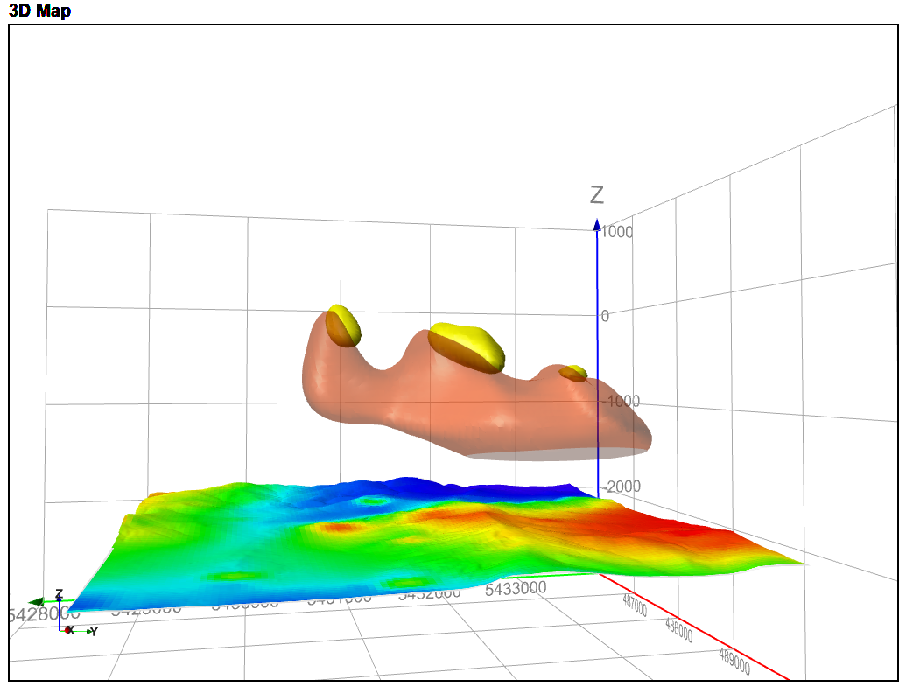
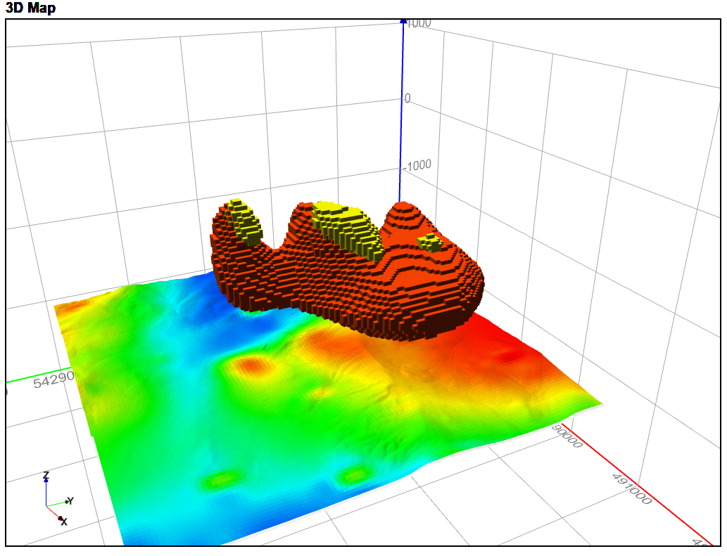
Correlation between the two models
In the figures above, TMI model is in red and VRMI model is in yellow. These models have been clipped to >0.002 SI. The two models overlap moderately well. There is a bit of lateral offset with the VRMI, suggesting at least some remanence is present. TMI model shows a deep, wide magnetic zone, which the Rookery Creek anomaly appears to be a pinnacle of. The TMI model shows that this zone dips moderately eastward, as it appears to in the regional images.

Slide 7
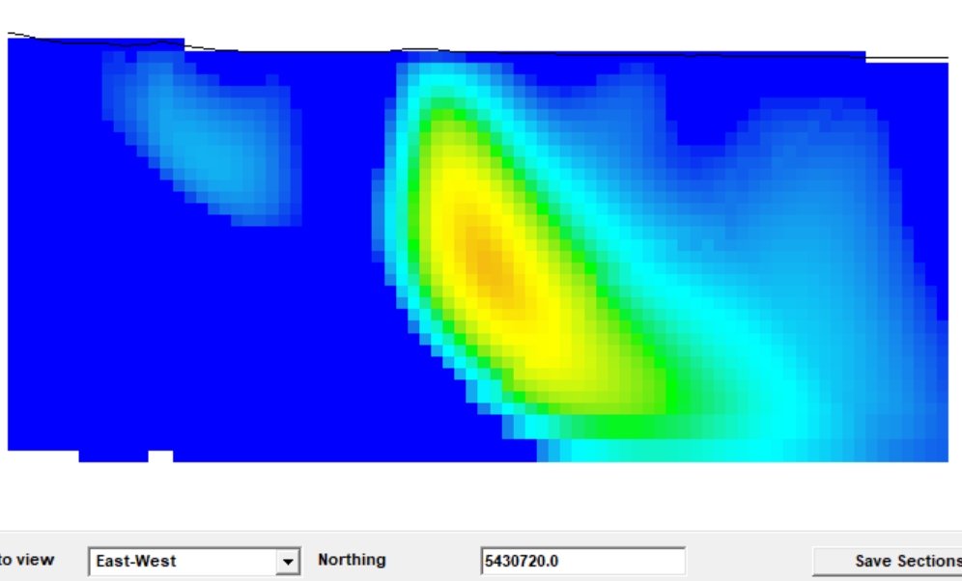
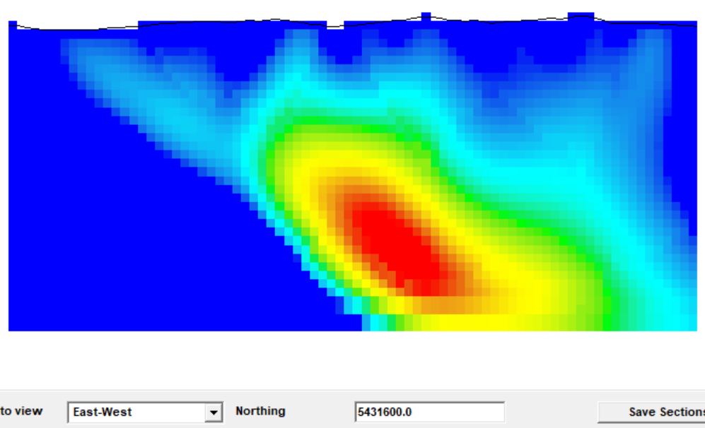
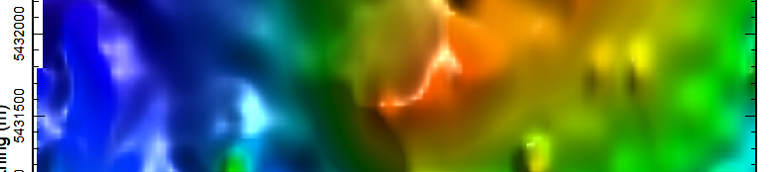
Things to be mindful of while using the models
The western boundary of the target anomaly is not well defined. This type of low sus halo is a common sign of remanence.
The bottom edge of the anomaly is not defined. The model has had a regional field removed, which means no information is available on lower boundaries
This type of very weak background magnetism is an artefact of the regional removal
There is definitely a large deep source at the northern edge of the target area, but the model is not reliable for this feature because it was not set up to image large scale deeper crustal sources.

