Slide 1
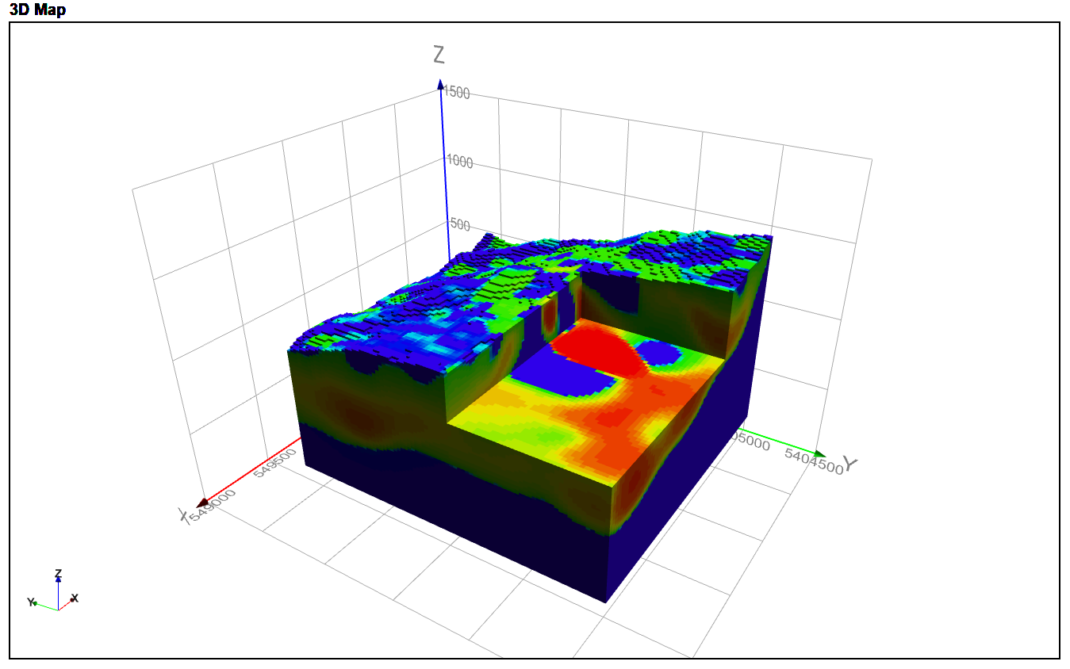
BenLomond unconstrained smooth model

Slide 2
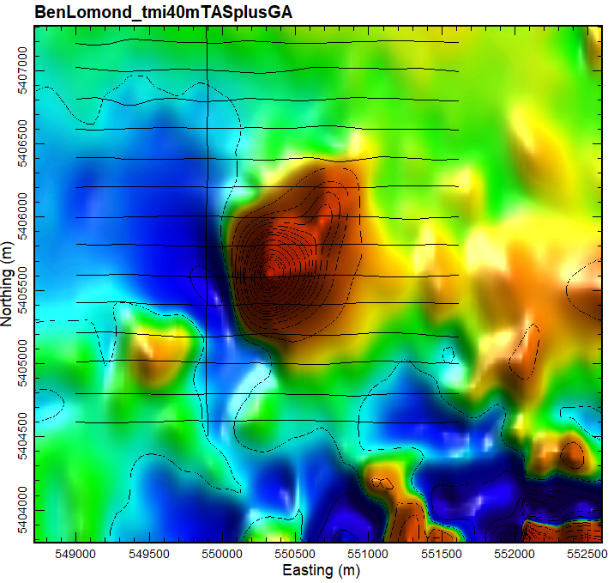
Introduction
Josh Phillips (JP geoscience) requested an unconstrained smooth model inversion of a strong (>1000nT) magnetic anomaly in the BenLomond
The anomaly is ~1300m NE by ~900m NW.
The existing magnetic data is the 2007 NE Tas helimagnetic survey, on 200m E-W lines (shown to the right)
The width and character of the anomaly suggest a shallow magnetic source
There is also clearly some remanence, as evidenced by the strong magnetic low on the SW side of the response
I used the mginv3D algorithm developed by John Paine (Scicomapp Pty Ltd), which is based on the UBC approach in inverse modelling
The model mesh is 25x25x12.5m
Compression using Daubechies Wavelet 4, with moderate depth weighting (beta 3, znot 50)
Terrain model is the 5m GA elevation model
TMI inversion used the point data and true terrain offset (radar alt). This produces a better fit in areas with strong topography
50nT contours, TMI and flight path

Slide 3
……continued
The VRMI (vector residual magnetic intensity) inversion used the transformed VRMI grid and 70m constant terrain offset
What is VRMI?
In short, VRMI is a non-scientific approach to minimising effect of remanent magnetisation
The VRMI filter aims to put the magnetic high directly on top of the actual magnetic source.
For bodies with no remanence, the VRMI is roughly the same as TMI. For sources with strong remanence, the VRMI can is more likely to put the magnetic high in the right location.
We can use the VRMI model to see if the TMI is badly affected by remanence. If there is a big offset (laterally) then this is evidence that the TMI model is invalidated by remanence and should can not be trusted
A model which uses VRMI usually makes everything deeper, wider, less magnetic, and removes deep sources. This is a result of the way that VRMI is calculated.
The VRMI is the magnitude A of the anomalous magnetic field response B, that is A = sqrt(Bx2+By2+Bz2)
VRMI is not reliable, but so is the TMI modelling with no information on remanence
50nT contours, TMI and flight path

Slide 4
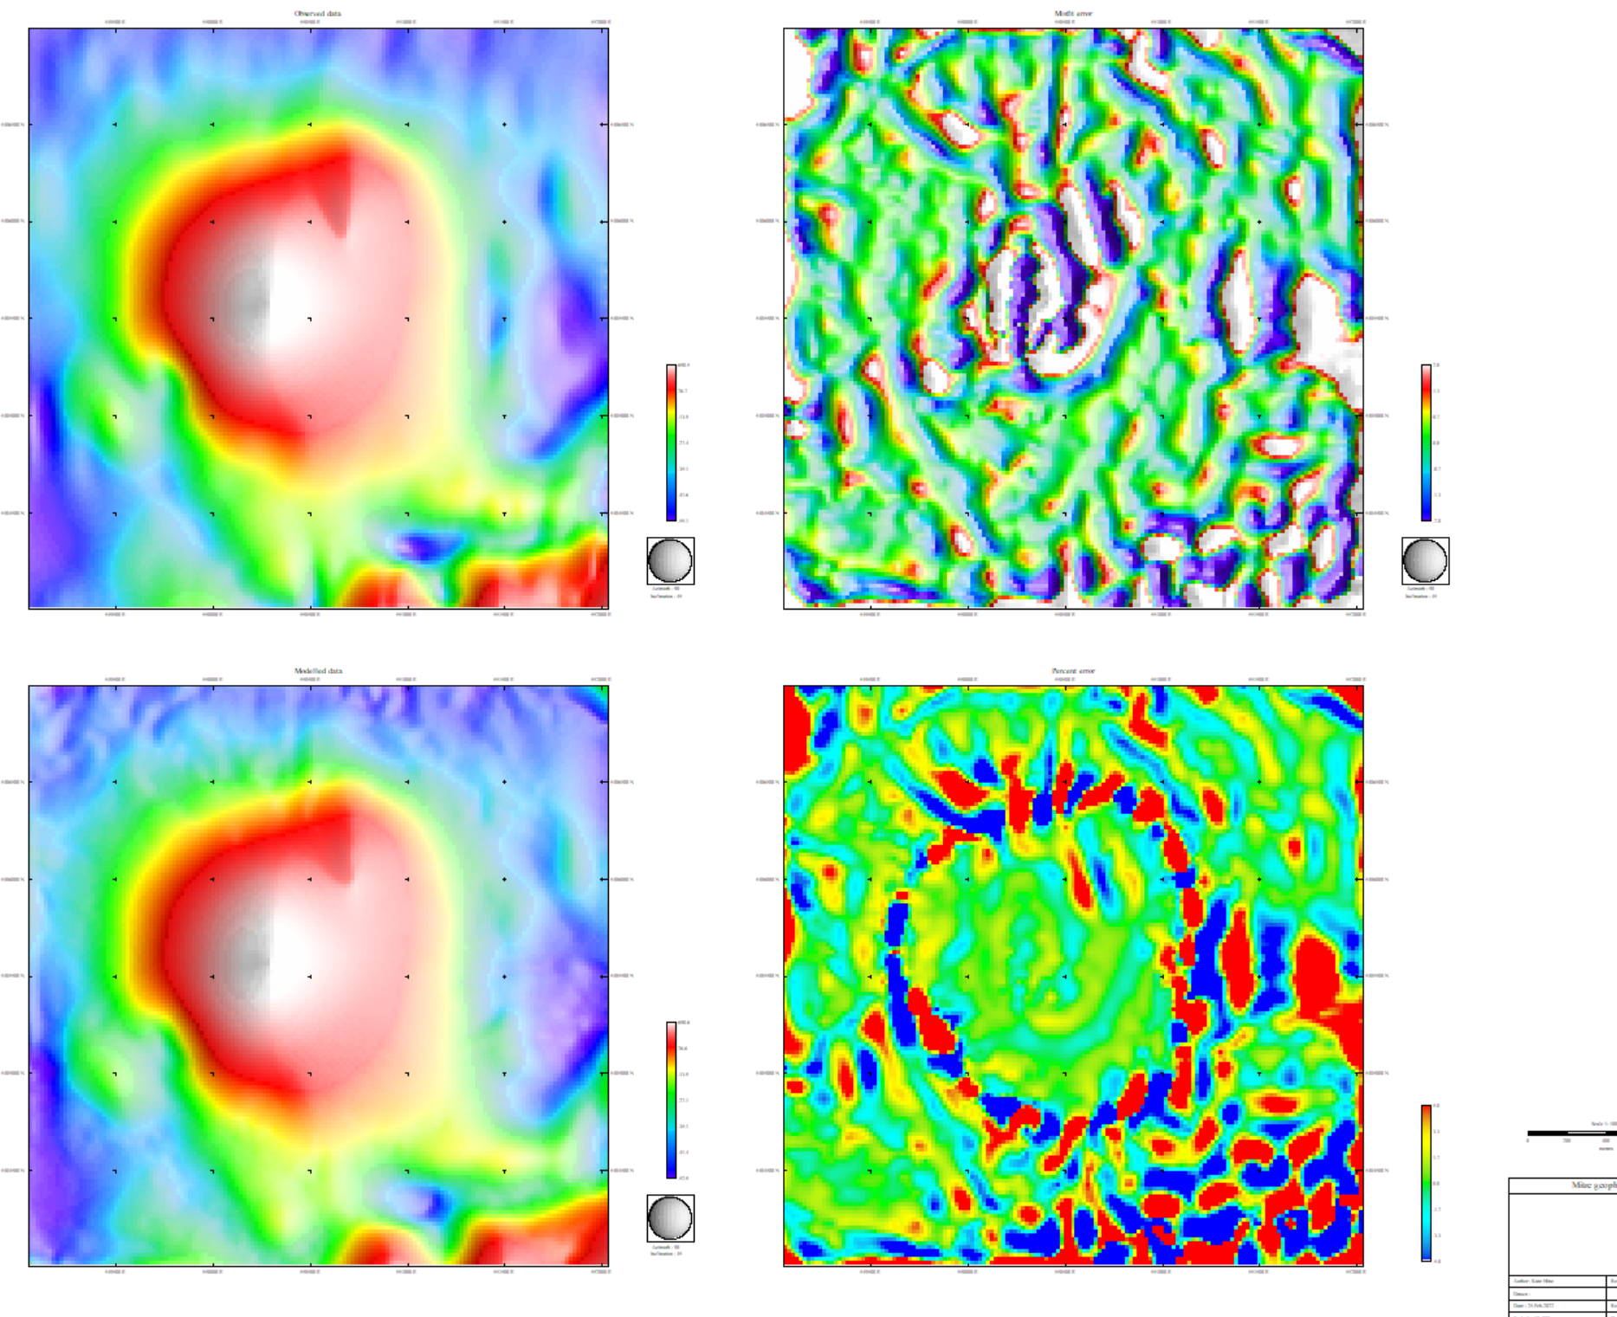
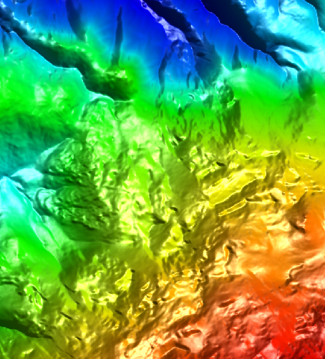
BenLomond_VRMI_Coarse .msh&sus
Topography
These patterns in misfit match topography reflecting the fact they are sensor height readings
Here the misfit is related to topography. The actual sensor elevation is variable whereas model assumed that the sensor is at 70m

Slide 5
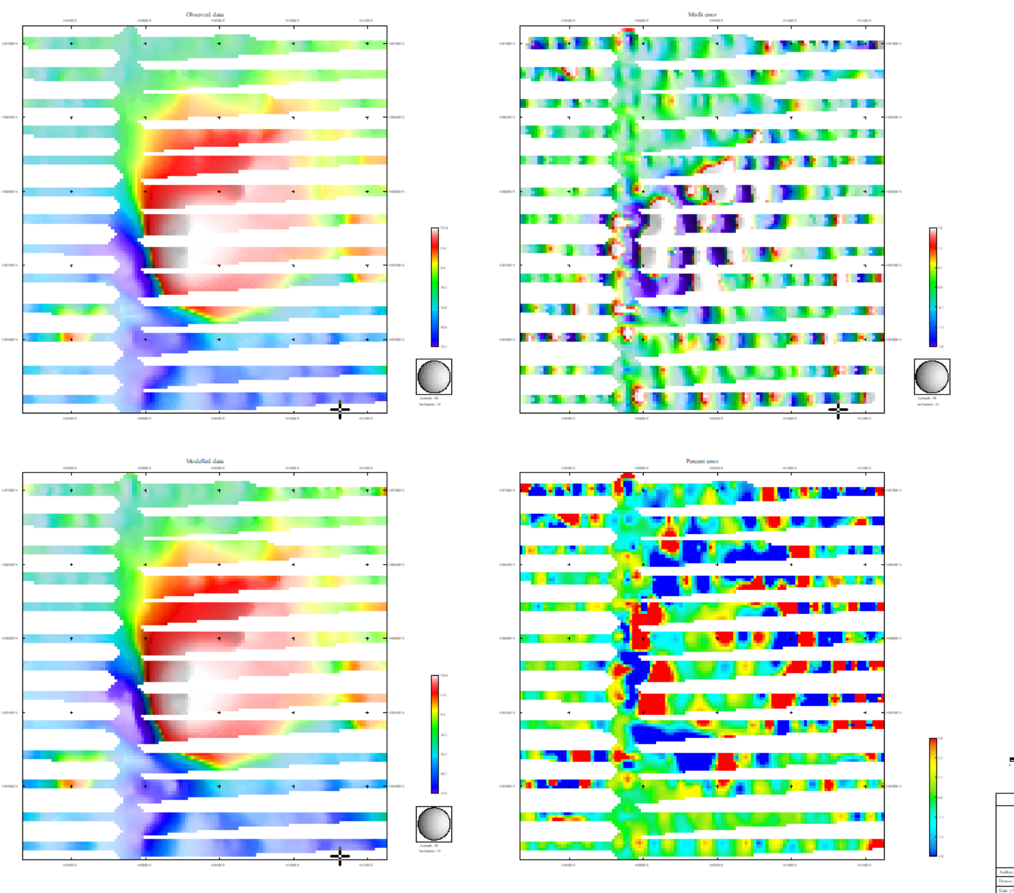
BenLomond_TMI_coarsemsh&sus
Unlike VRMI, the TMI model uses the actual mag readings and thus gets the correct radar altimeter level for each point (rather than assuming a constant 70m above surface). This minimises errors in the model due to incorrect height. As is shown here, the ‘modelled response’ is a significantly better fit to the observed data, but there are still clearly strong topographic effects, particularly where the helicopter elevation isprobably different than what the radar altimeter estimates
We can not really say if this is a better model than the VRMI because there are still strong misfits. In this case, the misfits are primarily at the edges of the source. This type of patter suggest the ‘smooth model’ approach is struggling to fit what is probably a quite sharp boundary in the actual geology.

Slide 6
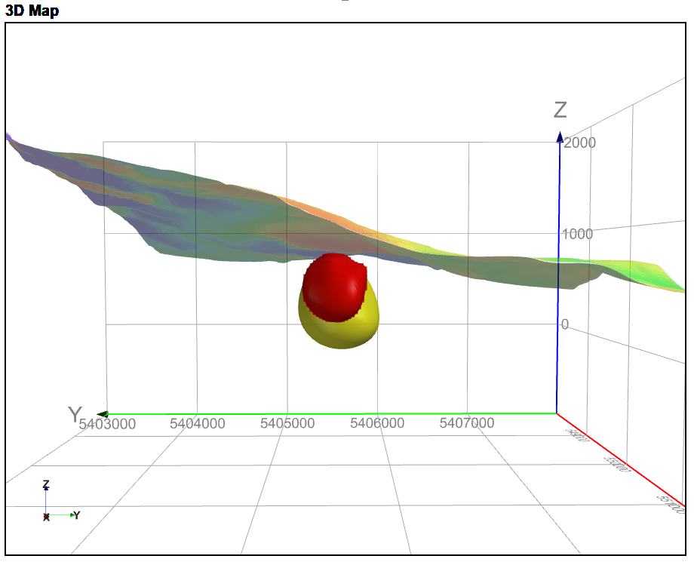
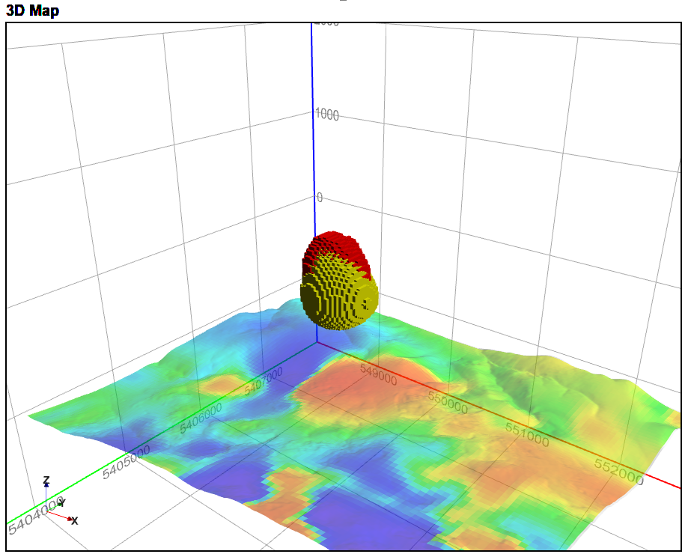
TMI and VRMI model comparison
In these figures, the TMI model is in red and the VRMI model is in yellow. The VRMI puts the source deeper, but that is probably just due to the nature of the filter i.e. not accurate. Neither model gives a good estimate of depth extent.
These models have been clipped to >0.05 SI. It is evident from these figures that the models overlap each other quite well. The TMI model is probably a better estimate of depth to top.

Slide 7
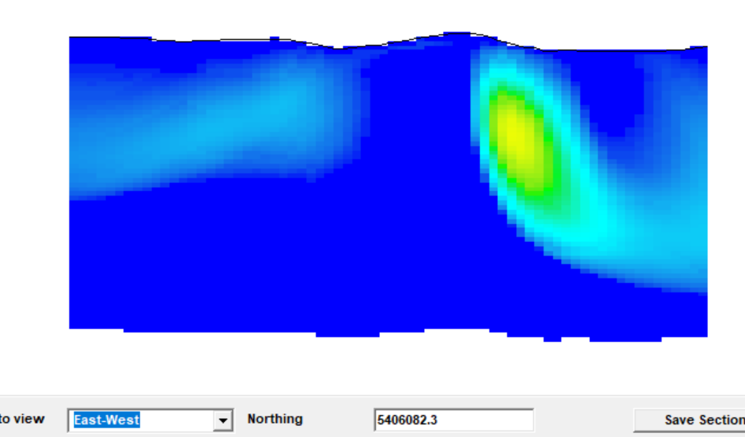
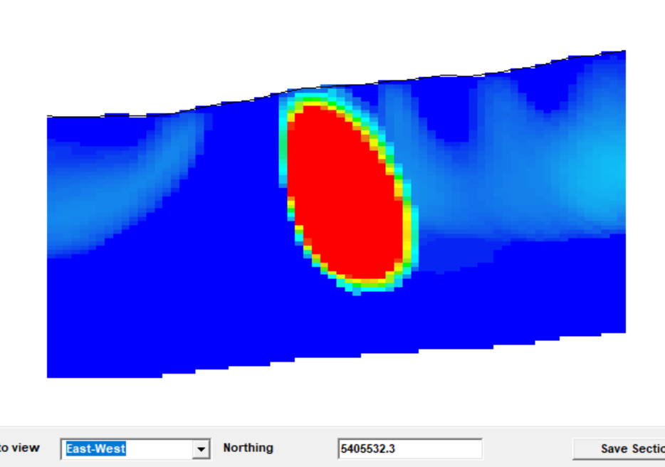
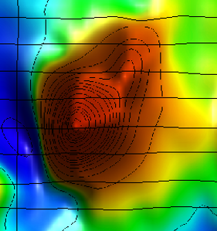
Things to be aware of while interpreting the model
The type of features at the edge of the model are because of the edge effects
This is an artefact of the regional removal
There is an undefined margin of the magnetic anomaly because of remanence in this area
Depth extent is not defined because we ‘remove’ the signal from deeper sources

