Slide 1
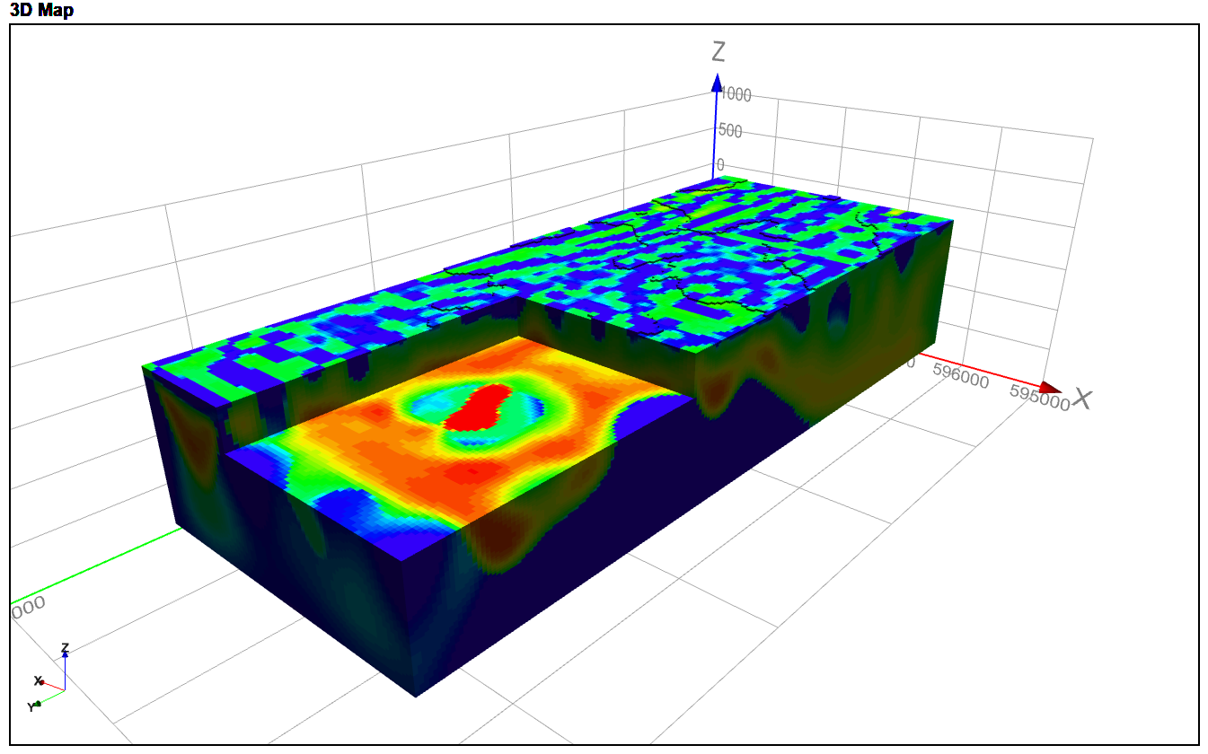
Musselroe Bay unconstrained smooth model Kate Hine, Mitre Geophysics Pty Ltd

Slide 2
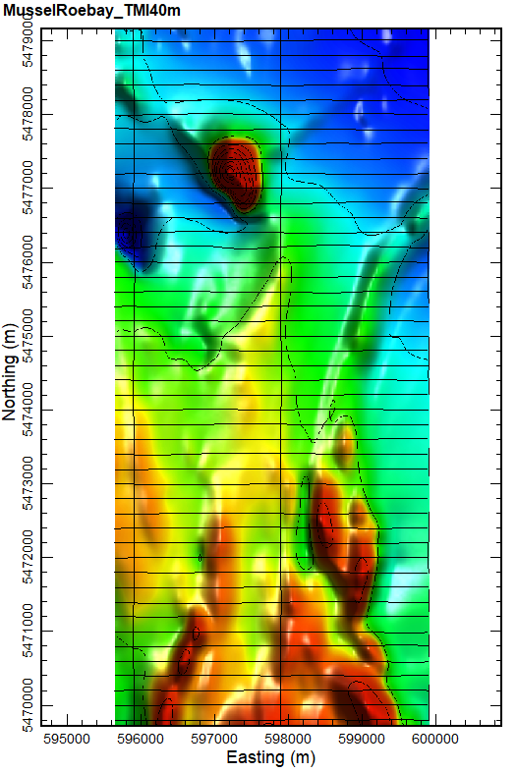
Introduction
Josh Phillips (JP Geoscience) requested an unconstrained smooth model of a strong (~220nT) magnetic anomaly at Musselroe Bay
The strongest magnetic anomaly in the area is ~900m NS by ~600m EW but the target area is 5km NS by 1km E-W
The existing magnetic data is the 2007 NE Tas fixed wing survey, on 200m E-W lines (shown to the right)
The width and character of the northern anomaly suggest a shallow magnetic source with a significant depth extent
There is also probably some remanence, as evidenced by large magnetic lows southwest of the target anomaly.
I used the mginv3D algorithm developed by John Paine (Scicomapp Pty Ltd), which is based on the UBC approach to inverse modelling
The model mesh is 30x30x30m for the TMI, and 40x40x20 for the VRMI
Compression using Daubechies Wavelet 4, with default depth weighting
Terrain model is the SRTM 1Second DEM
TMI inversion used the point data and true terrain offset (radar alt). This produces a better fit in areas with strong topography
This reversely polarised anomaly is due to remanence in the opposite direction to the current earths field
20nT contours, TMI and flight path

Slide 3
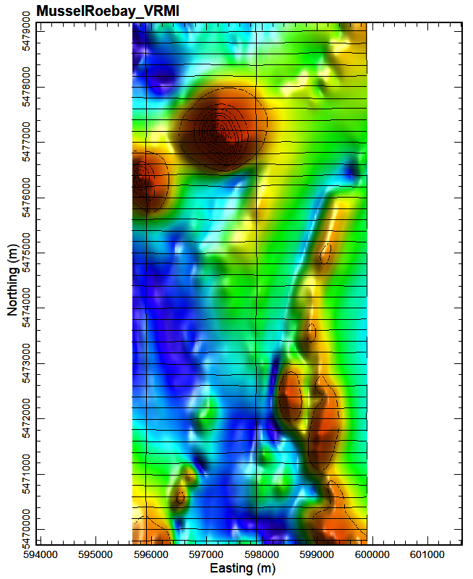
……continued
Note how this reversely polarised mag anomaly is now a positive!
The VRMI (vector residual magnetic intensity) inversion used the transformed VRMI grid and 70m constant terrain offset
What is VRMI?
In simple words – VRMI is a non-scientific attempt to minimise the errors that remanently magnetisation causes in magnetic modelling
In areas of strong magnetisation, the TMI peak is offset from the true source, whereas (we hope), the VRMI algorithm puts the peak over the source
This means that any model based on TMI could put the source in the wrong location.
By comparing the VRMI model with the TMI model we can see if there is much evidence of remanence. Specifically, we are looking for a lateral offset between each model. If there is a significant offset then it highly likely a drill hole based on the TMI alone would miss.
A model which uses VRMI usually makes everything deeper, wider, less magnetic and removes deep sources. It is because of the way the VRMI is calculated
The VRMI is the magnitude A of the anomalous magnetic field response B, that is A = sqrt(Bx2+By2+Bz2). The vector components are calculated from the TMI
Modelling VRMI is not perfect, but so is TMI modelling with no information on remanence
20nT contours, VRMI and flight path

Slide 4
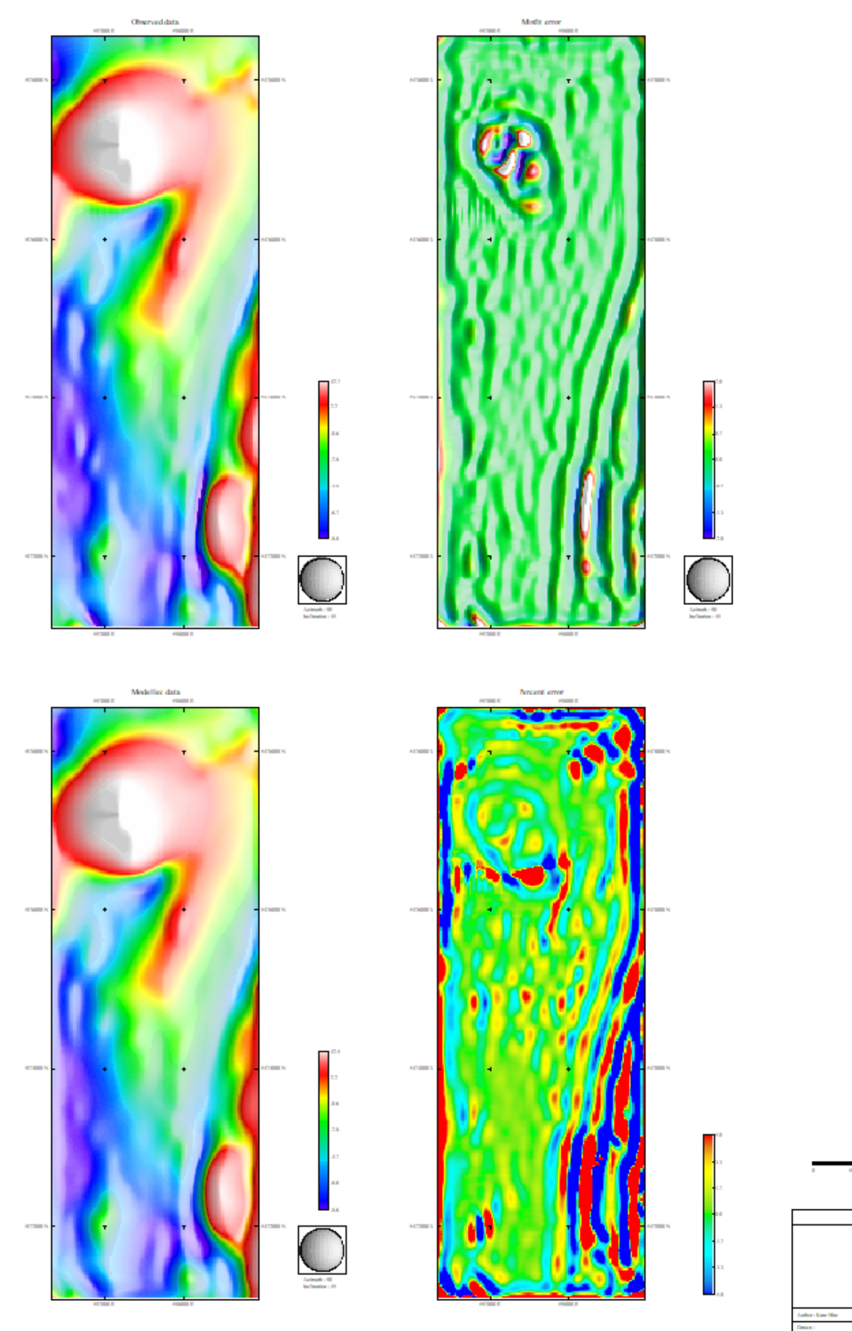
Inversion model quality analysis MusselroeBay_VRMI_coarse.msh&sus
Here the misfit is around the edge of the anomalies due to the fact that the VRMI is not a true magnetic field and thus does not have a quite right shape to be fitted with the TMI model. There are also grid edge effects, but otherwise the model is a satisfactory fit to the data.

Slide 5
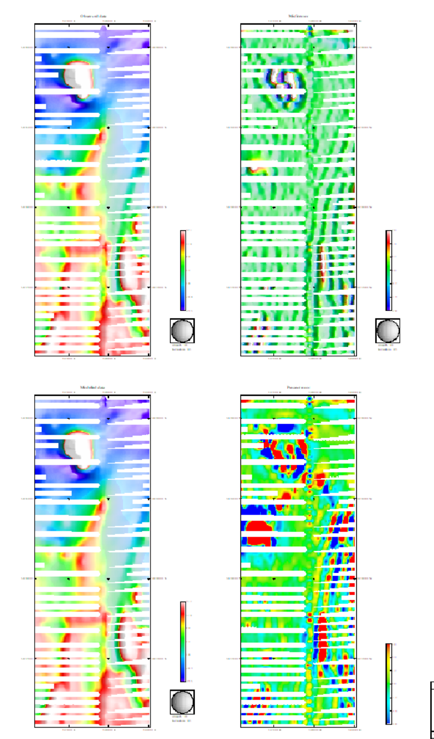
Inversion quality analysis MusselroeBay_TMI_coarse.msh&sus
Misfit error does not resemble topography, so it is not related to an improper height. These errors instead are an evidence of significant remanence in the source (which TMI inversion does not take into account and thus can not ‘fit’)
Large misfits due to remanence here
The misfits in this model are all almost certainly at least partly related to remanence. This is particularly apparent for the anomaly circled left. This does not invalidate the model results, but it does suggest caution in using either model for drilling purposes. Go back to the geology!

Slide 6
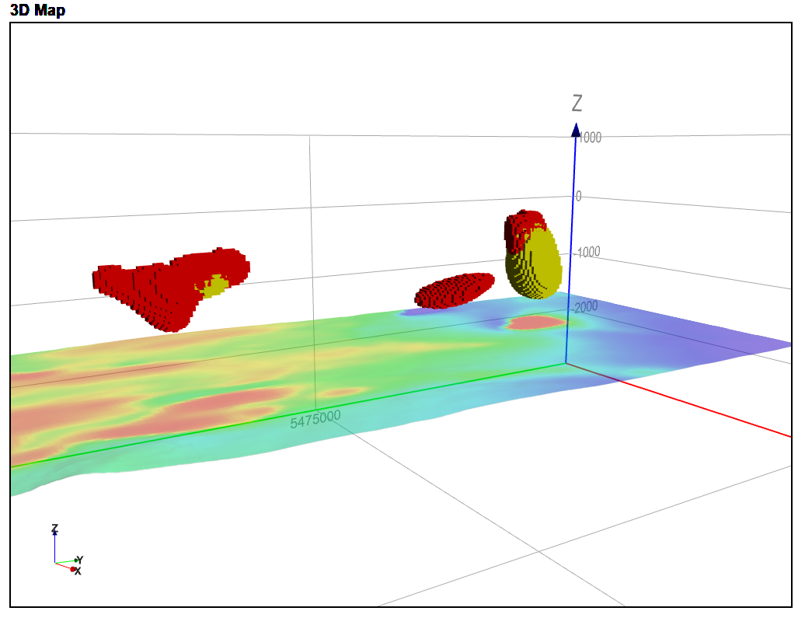
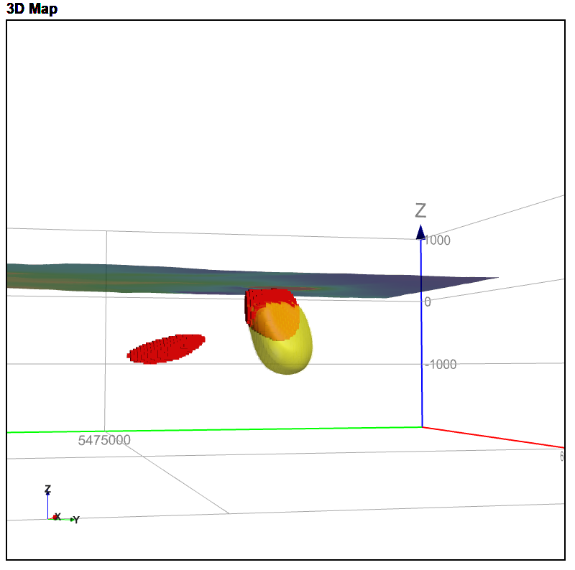
Correlation between the two models
In the figures above, the TMI model is in red and the VRMI model is in yellow. Overall, at least for the northern anomaly, they are quite similar. In other words, it should be possible to design one drill hole which effective tests both. Note that it is highly likely that the source is actual several narrow magnetic zones, but that this type of model is unable to resolve them. These two models have been clipped to >0.004 SI mag sus.

Slide 7
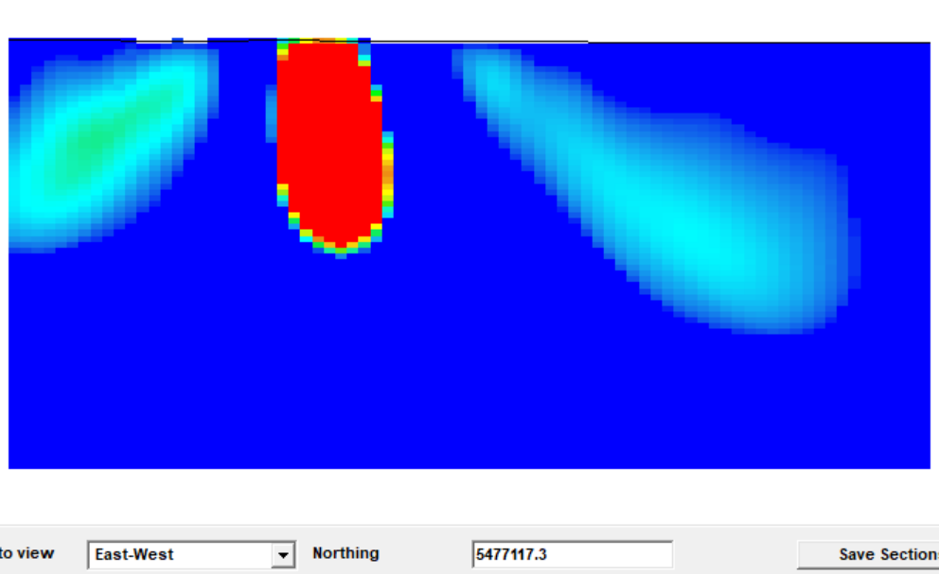
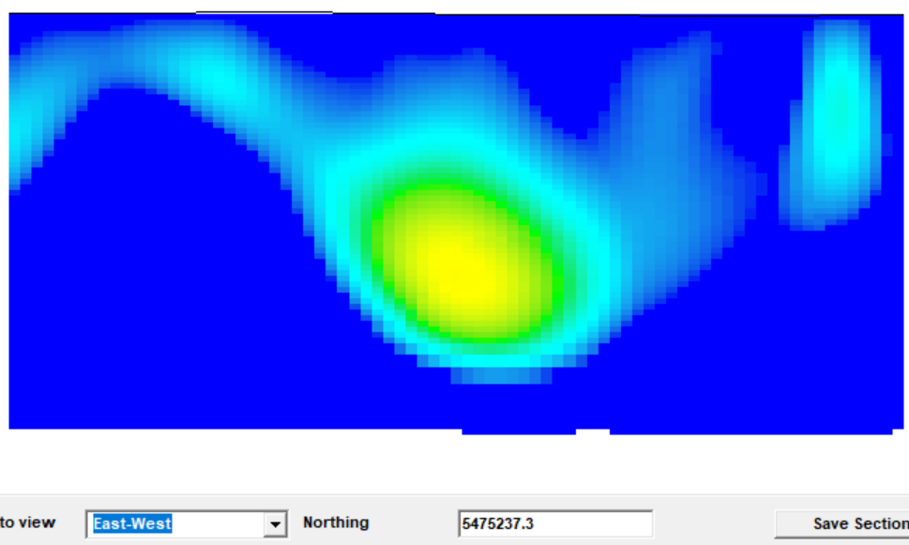
Be mindful of a few things …..
This is an artefact of the regional removal and is not reliable
The margin of this magnetic high is not defined. Anomalies with sharp boundaries, particularly those with strong remanence, always show these ‘low sus’ shoulders which are not a physical reality. This is a well documented problem with these types of inversion, and yet to be solved.
Features at the edge of the model are highly unreliable because of edge effects
The model makes a large smooth deep weak blob, but it could equally be a narrow strongly magnetic dykes. Smooth models, by their nature, will make everything deep out to be ‘weak and large’ rather than narrow and strong
Also, due to the regional removal, the depth to base is not defined. We have essentially ‘subtracted away’ any deeper material in order to calculate the model

